Slide 1
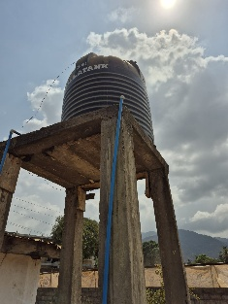
Sanitation
Project
Hastings Sierra Leone Friendship Link

Slide 2
Review
Feb 26
Feb 26 Visit to assess current projects
Grafton Model Baptist
REC Maynard
REC Primary, Kossoh Town
The good, the bad & the ugly
Future plans
Health Centre, Twin Town Centre & collaboration

Slide 3
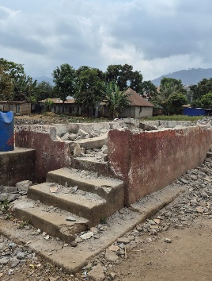
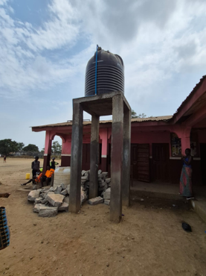
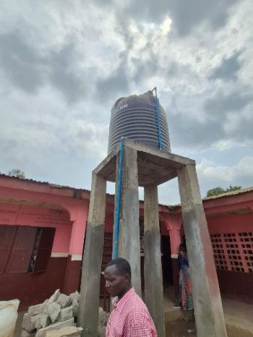
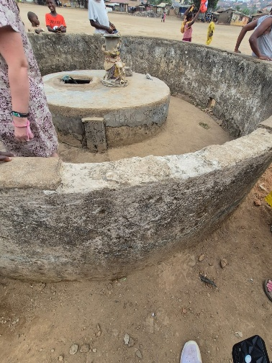
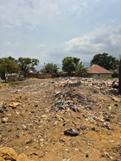
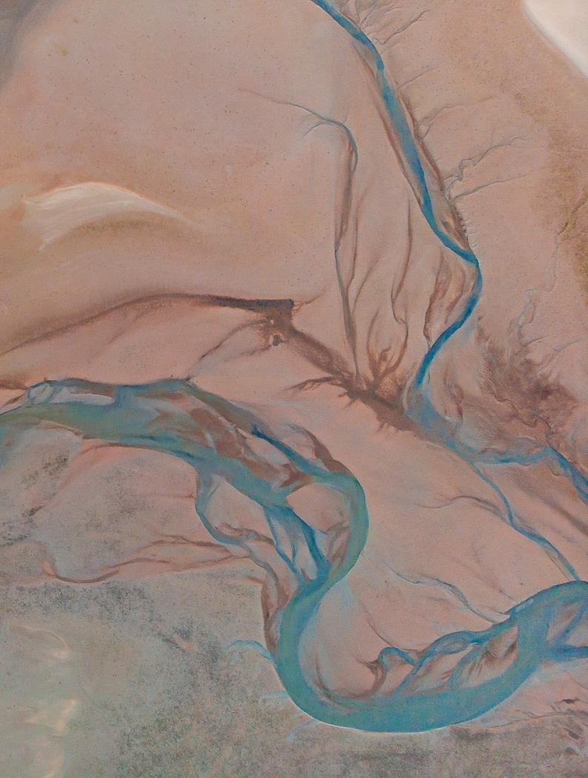
Grafton Model Baptist
While we were originally informed that everything was working satisfactorily, there were multiple issues.
Local vandalism had resulted in the hand pump being broken and removed.
No access to mains power rendered the submersible pump useless.
Exposed cabling was left by the well to allow a generator to be attached to run the pump. As they do not have generator, they claim to periodically borrow one. This seems unlikely, given the frequency they would need to fill the tank.
Water was extracted using a rope and bucket, demonstrating it is not dry yet which is often the case, even early in the dry season.
Several members of the school leadership team were present and expressed that while there were issues as described above, water was not their primary concern. A bigger problem was with the community and lack of security. Severe issues with large areas of school ground being used as a rubbish dump, traffic encroaching on what should be safe space for children, and vandalism/damage to school farm and school property. We have been advised that they have requested assistance with a boundary wall for some years. In addition, following flooding in the rainy season, one of the toilet blocks has had to be demolished for safety. There was disagreement between the contingent as to which should be prioritised, toilets or security. Water was a distant 3rd place!

Slide 4
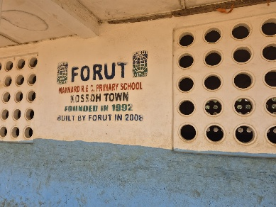
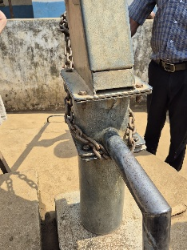
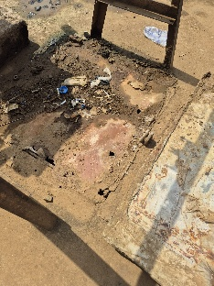
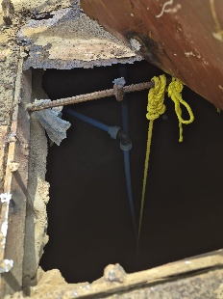
REC MaYNARD
We had conflicting reports as to why this project had failed. Pipework to water tower was visibly incomplete/damaged. Staff on site advised there wasn’t a pump fitted so it would never have worked. They also demonstrated a fault with the handpump. As the opening was welded shut and had a heavy stone (it took 3 of the larger men to move!)
Similar to other schools, Maynard also lacked a power source to be able to power the submersible pump, so at the point of installation, it would only ever have worked as a manual hand pump.
I asked if a similar solution to Grafton could work with a generator being used . Kainde suggested that they did leave a similar connection point but that this had since been covered over. He also advised that the hand pump should be a simple replacement bolt. The submersible pump had been recovered but as unused for a prolonged period, had evidently seized. We did pay Kinde to send this away to be repaired and I understand it was returned and shown to work. The submersible was returned the following afternoon and a generator used to test the system which appeared to work. A further update will be required to ensure the pipework to tower is sufficient for the system to work .

Slide 5
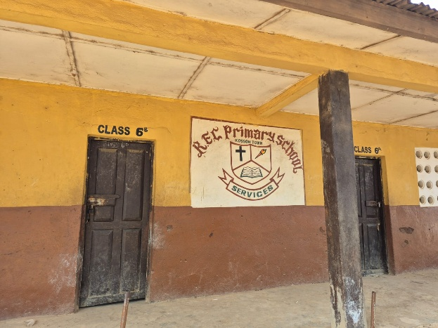
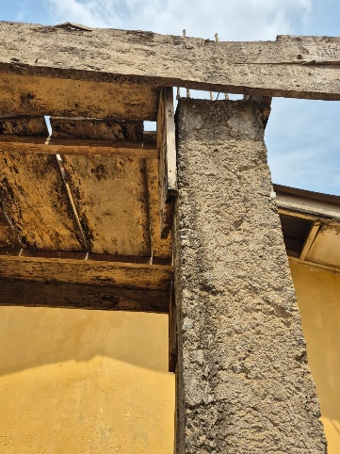
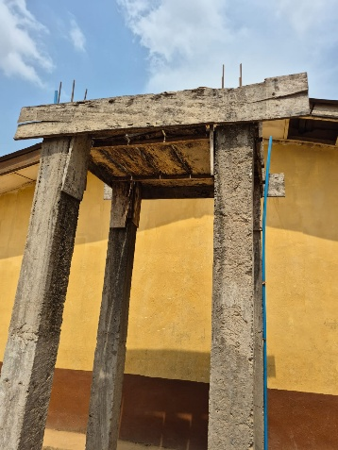
Rec Primary
Kossoh town
Contractor started work but tower incomplete. Advised that pipework from well had been completed but contractor failed to complete works. When questioned why they had been paid for incomplete job, Kainde advised that the previous jobs all completed without issue, so they trusted enough to release funds to complete works. Apparently, the contractor had a more lucrative contract with the Chinese and they have been uncontactable, despite best efforts.
Similar to Grafton, there is no power supply to the school to run the submersible pump, and it appears the well has not been deepened. Suffian lives immediately behind the school and mentioned that if works were to be completed, he would gladly use his own electric supply from his home to run the pump.

Slide 6
