Slide 1


Slide 2
School Activities
Partnerships
International Pupil Council
Joint Project – Protecting our Future
Visits
  October 2025 - Sierra Leone teachers visited Hastings UK
  February 2027 – UK teachers will visit Sierra Leone
Notes:
These are the main areas we have been working on this year.

Slide 3
Partnerships
32 schools
14 partnerships
Notes:
Our partnerships have grown. We are very pleased to say we have now got 3 more schools in Hastings UK partnered with schools in SL. Two of these are secondary schools, which we are very excited about.

Slide 4
Current partnerships
UK school | Sierra Leone partner school
Christ Church CE Primary and Nursery Academy | Kankalay Islamic Primary School
All Saints CE Junior Academy | Edest Nursery and Preparatory School
Battle and Langton CE Primary School | REC Jui Lower Primary School
Guestling Bradshaw CE Primary School | Maynard Primary School
St Leonards CE Primary Academy | Baptist Model Primary School
St Mary Magdalene Catholic Primary | Gateway
Sedlescombe CE Primary School Ninfield CE Primary Academy | Glory
St Paul’s CE Academy | REC Kossoh Town Primary School
Ore Village Primary Academy | St Mulumba
New Horizons Special School | Christ Standard
Ark Alexandra William Parker and Helenswood sites | Huntingdon Jui JSS and SSS
St Leonards Academy | Kelly’s
Sandown | REC Hastings
Little Ridge | REC Jui Upper Infant and Primary

Slide 5
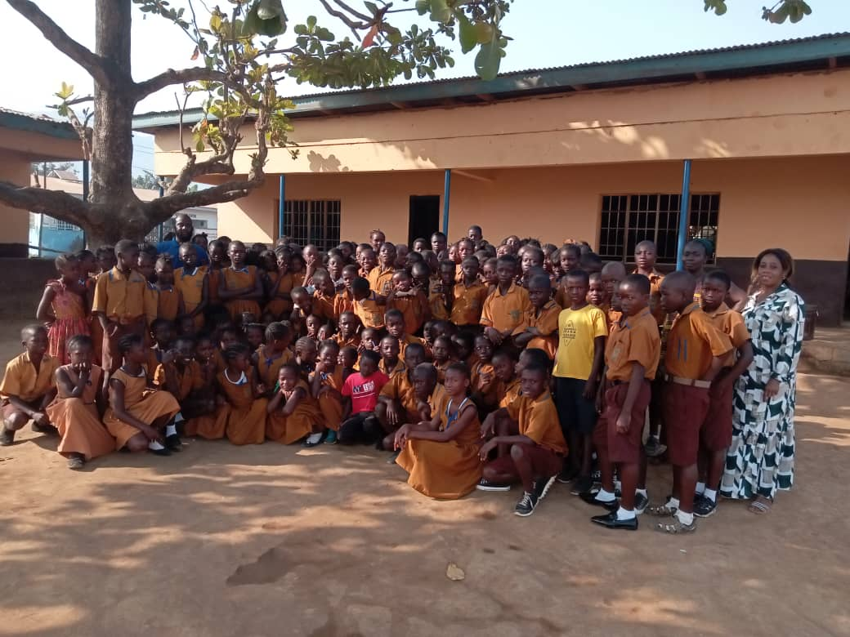
REC Hastings partnered with Sandown

Slide 6
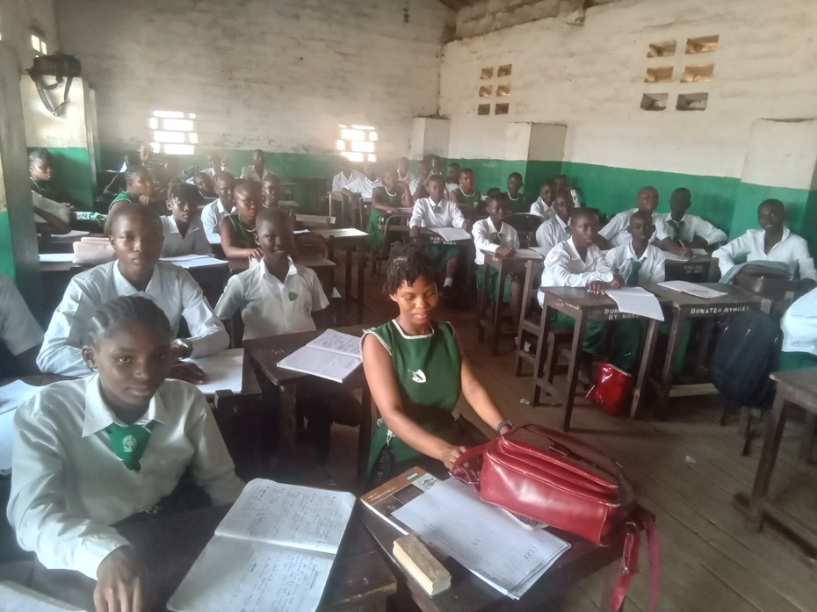
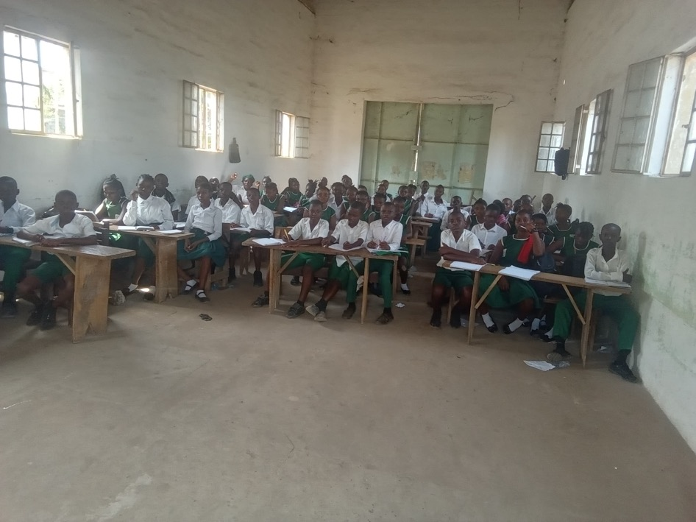
Huntingdon Jui JSS partnered with Arc Alexandra

Slide 7
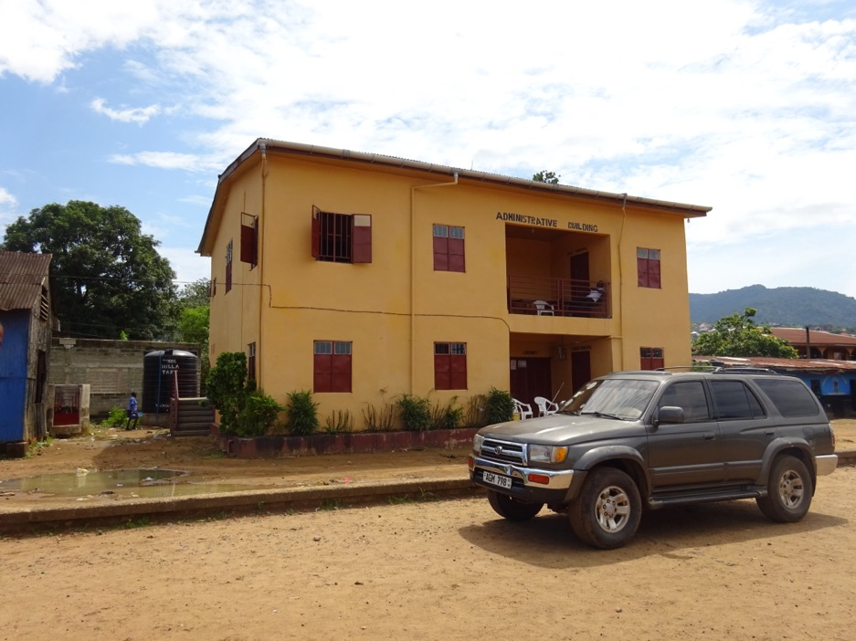
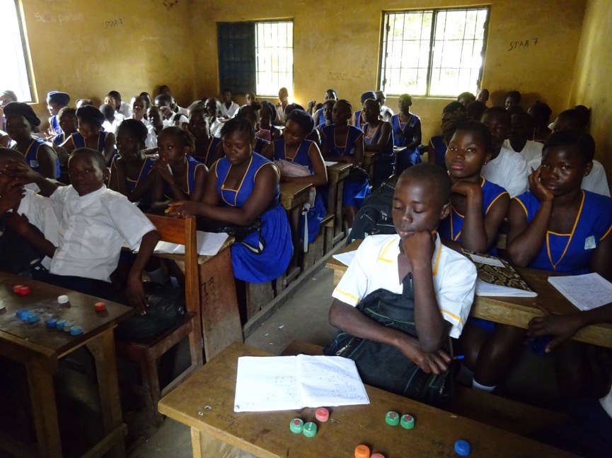
Kelly’s partnered with St Leonards Mulberry Academy

Slide 8
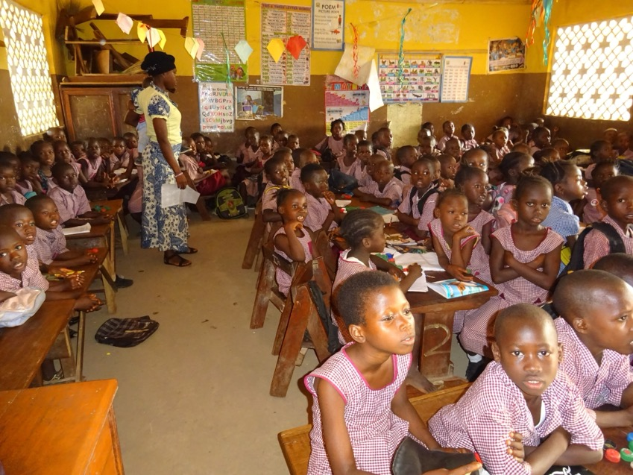
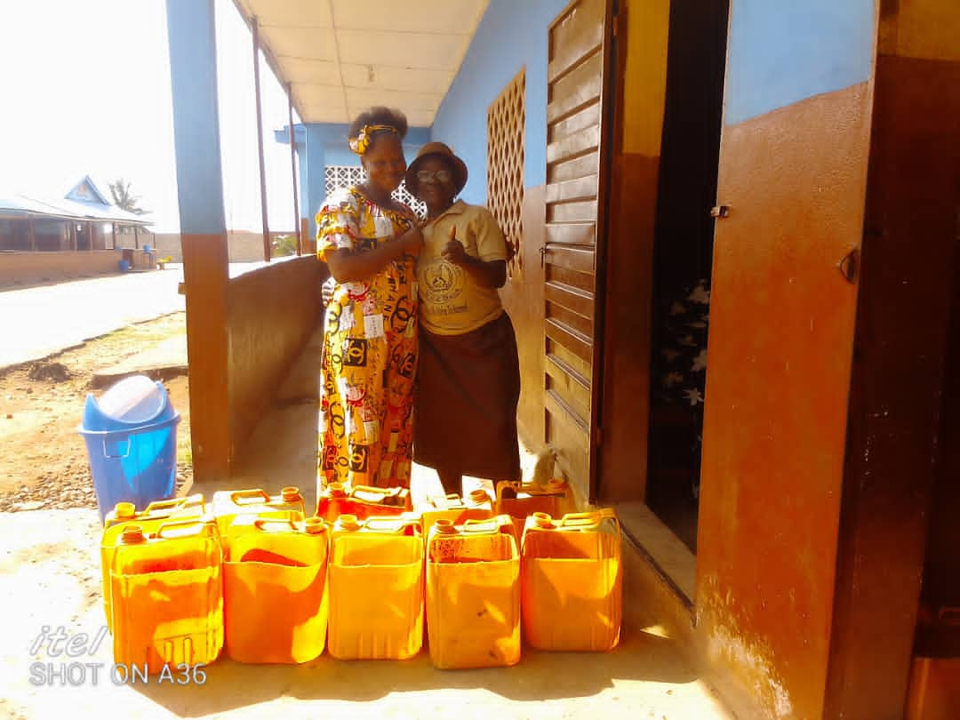
Little Ridge partnered with Jui Upper Infant and Primary

Slide 9
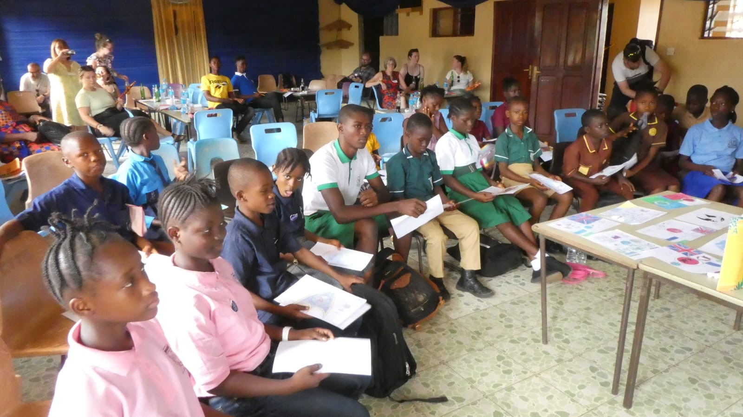
IPC meeting

Slide 10
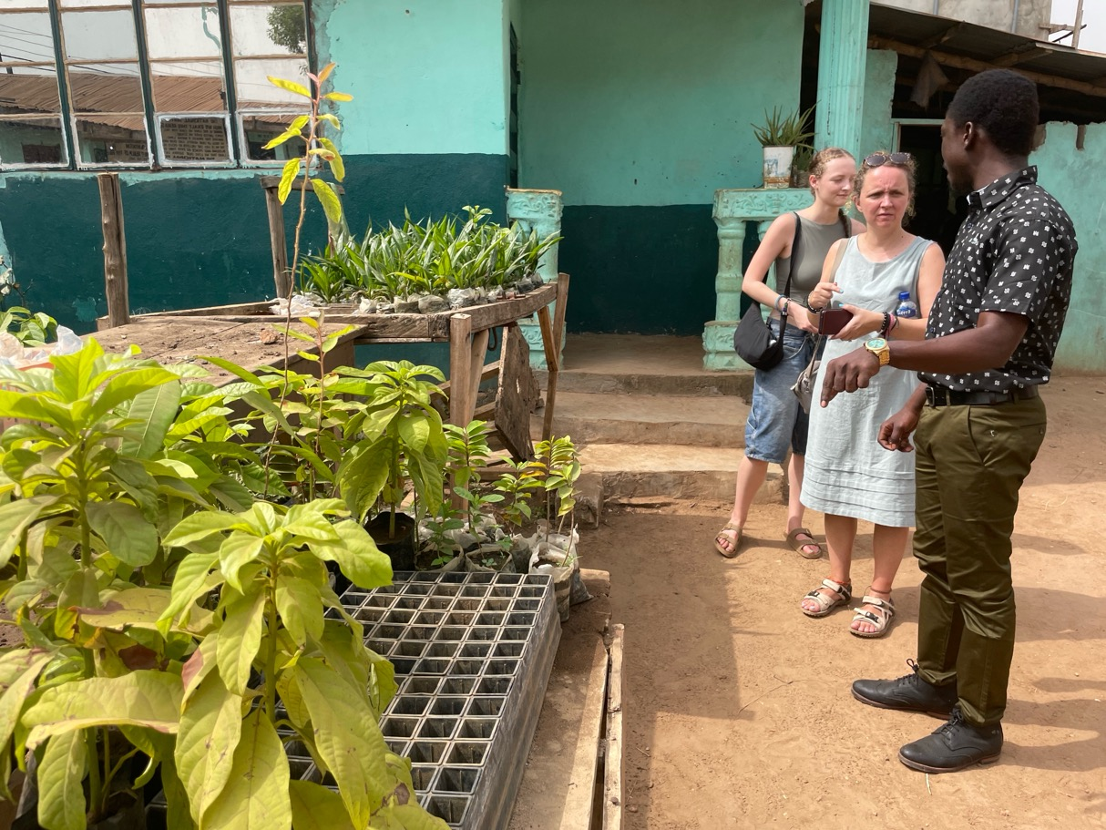
Protecting Our Future
Reduce
Re-use
Recycle

Slide 11
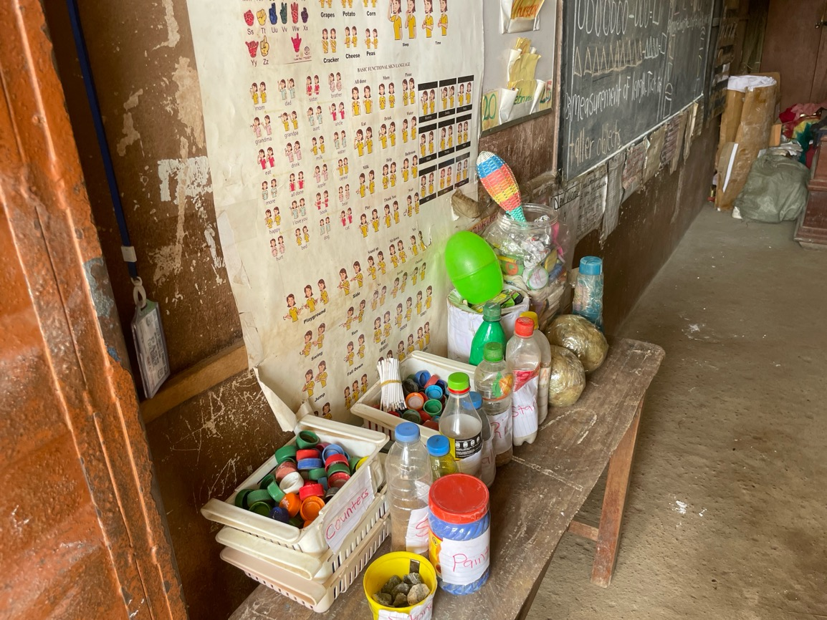
Protecting Our Future
Reduce
Re-use
Recycle

Slide 12
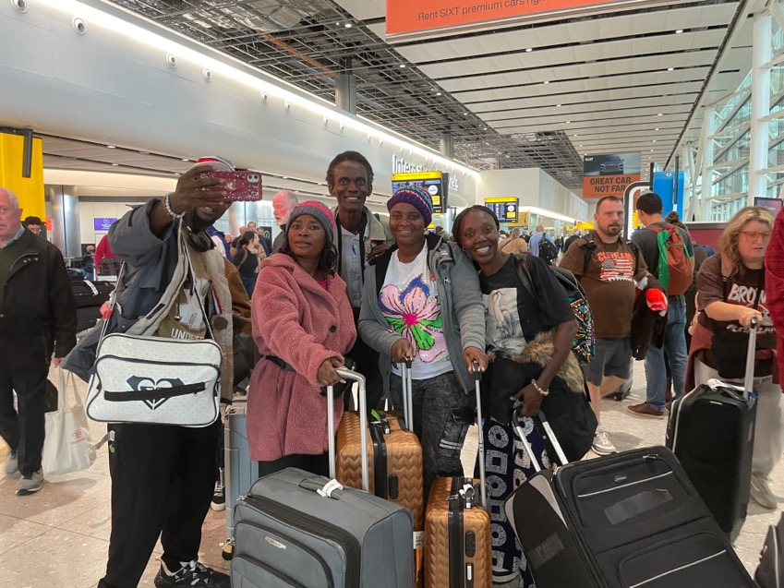
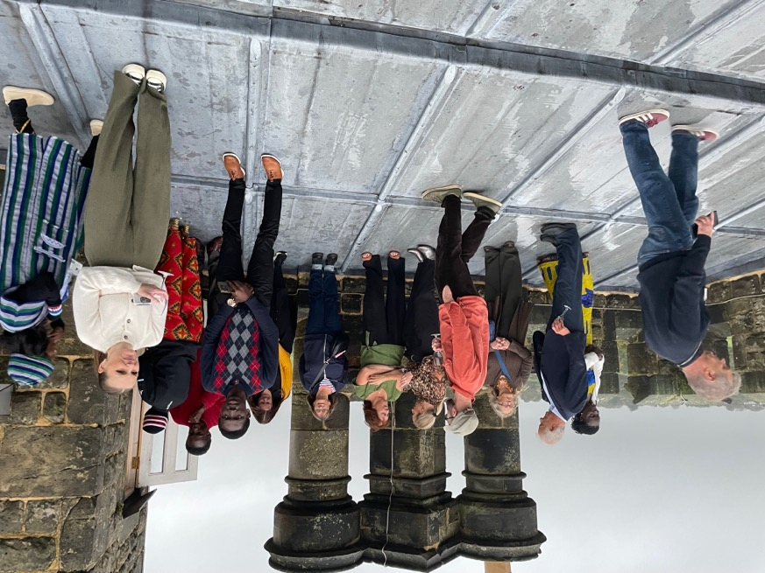
October 25 visit
Notes:
Very successful visit. Teachers spent most days in their partner school learning about education in UK and sharing their life and experiences with UK pupils and staff.
We organized a variety of out of school activities. We were lucky enough to be invited to Fairlight Hall for a tour of the house and a meal.

Slide 13
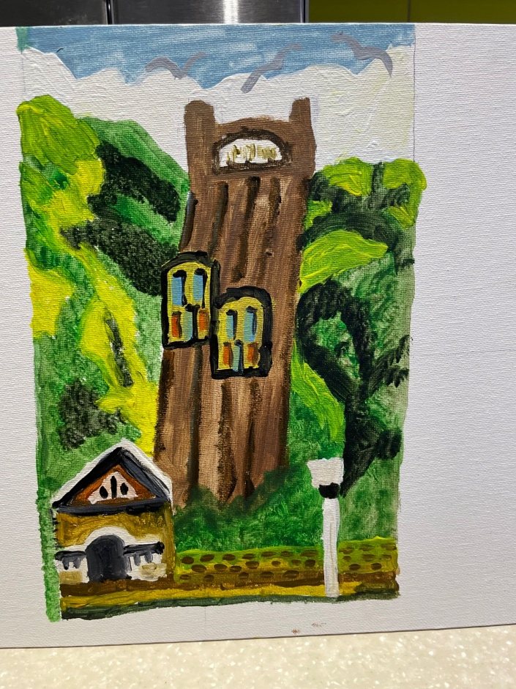
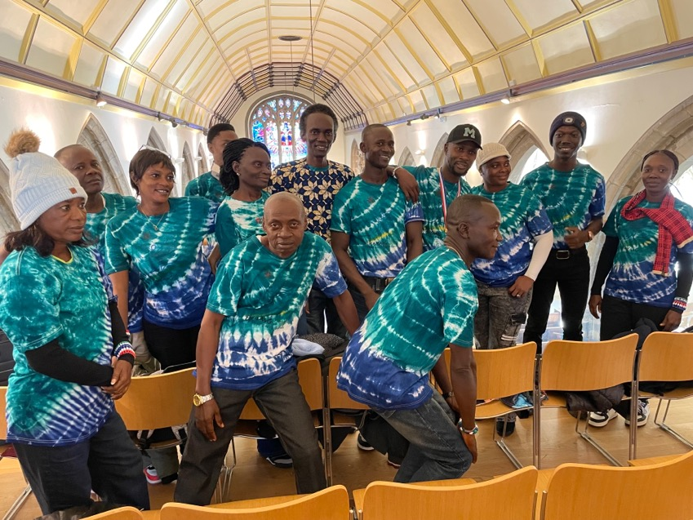
October 2025 Visit
Notes:
During the workshop where we has sessions on phonics and bodmas! We also had a lesson on Art where we created paintings of the East Hill lift.

Slide 14
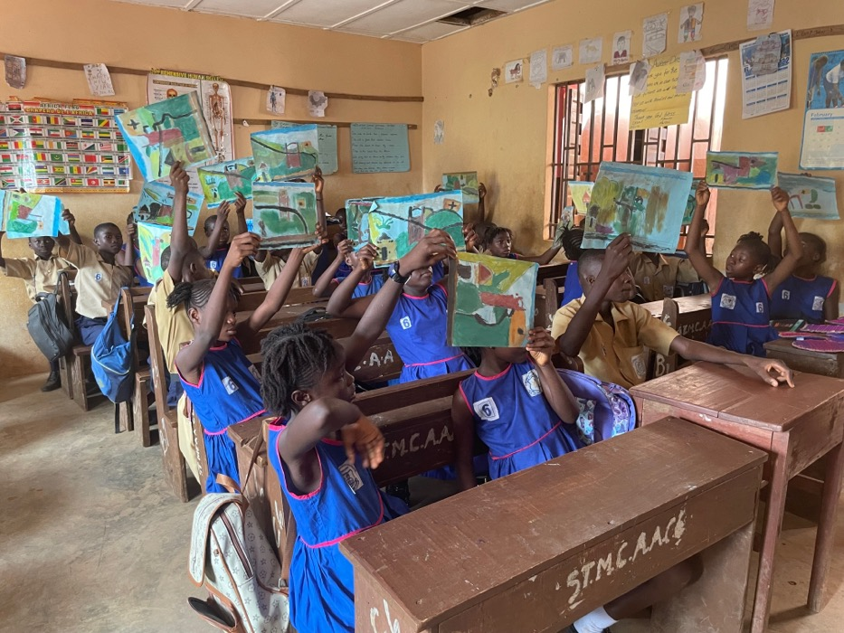
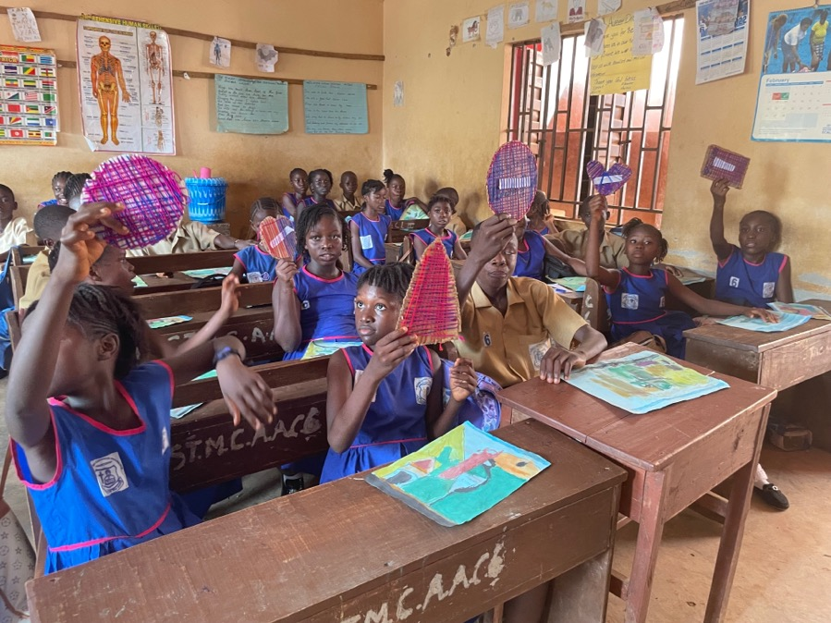
February 2026 visit
St Mulumba sharing Art work learnt in UK
Notes:
In Feb 26, Alex (trustee) and Jo (teacher) myself and Jo’s daughter visited SL. We saw some pupils art work that had been inspired by the workshop in the UK.

Slide 15
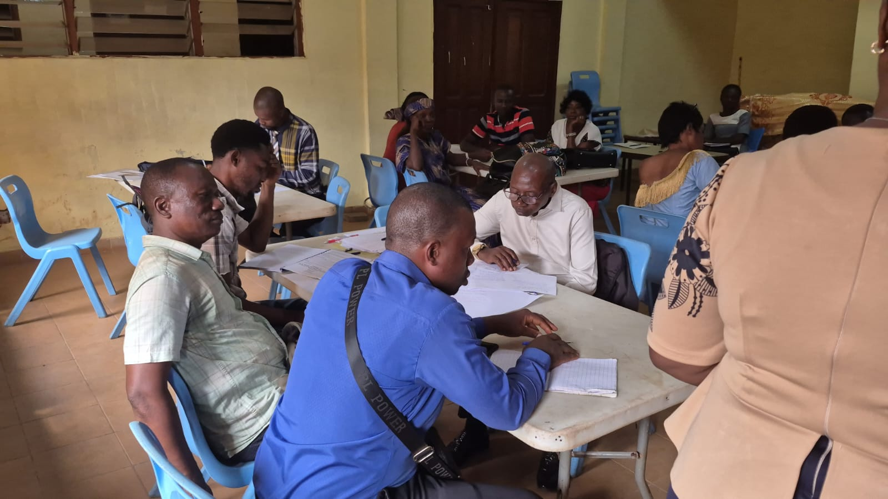
Workshop 2026
Notes:
We also ran a workshop where we asked what had been the best parts of the October visit, and what else teachers would like in the future.

Slide 16
What next for 2027
Teacher visit to Sierra Leone
Possible new link project to support schools working from their needs
More fund raising for visits and projects
Continue to build on our ‘Protecting our Future’ schools project
Notes:
We are now planning for our teachers to visit Sierra Leone next February. As you will be aware, the cost of flights has risen hughly since covid, and we will need to do some serious fund raising to cover this. Schools have their own ideas and we are looking for any help from other organisations. The teacher visits are the activity that keep the link alive, and the benefits to pupils, as well as staff, learning about global citizenship, how people live in other countries, what is the same and what is different is vital to our future understanding of the world.
Link is looking at starting a new project where activities come from the school needs.

Slide 17
School Farms Project 2026
Aims for 2026
Further increase community participation
Share learning opportunities through workshops and visits

Slide 18
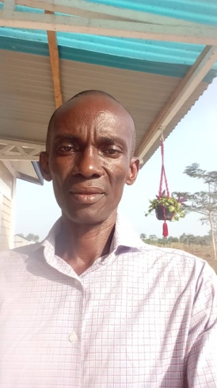
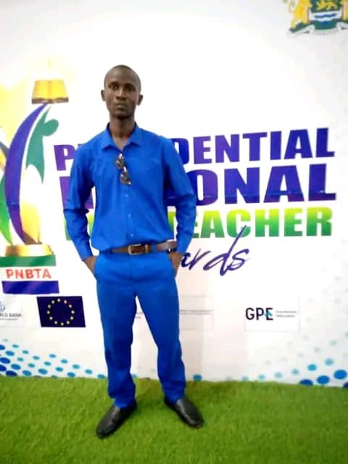
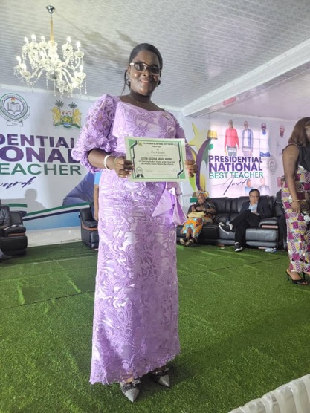
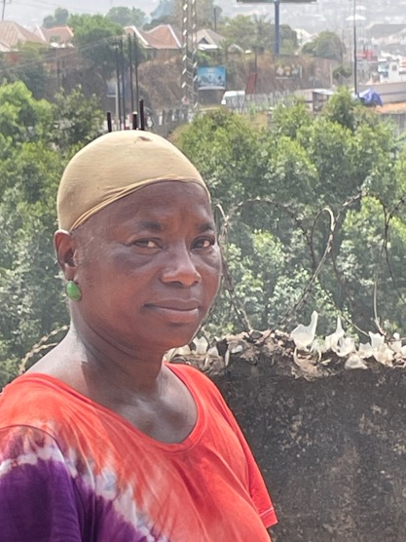
School Farms Sierra Leone Team
Francis Mason Suffian Kamara Letitia Huggins Mballu Barrie
Schools Coordinator S F Manager S F Manager S F Manager
Notes:
School Farms into its 6th year.

Slide 19
2026 update
School visits
  Positive feedback on community involvement and sharing ideas
    Jui Lower and the barracks!
    St Mulumba’s ideas to prevent pests
    Huntingdon Jui’s chickens

Slide 20
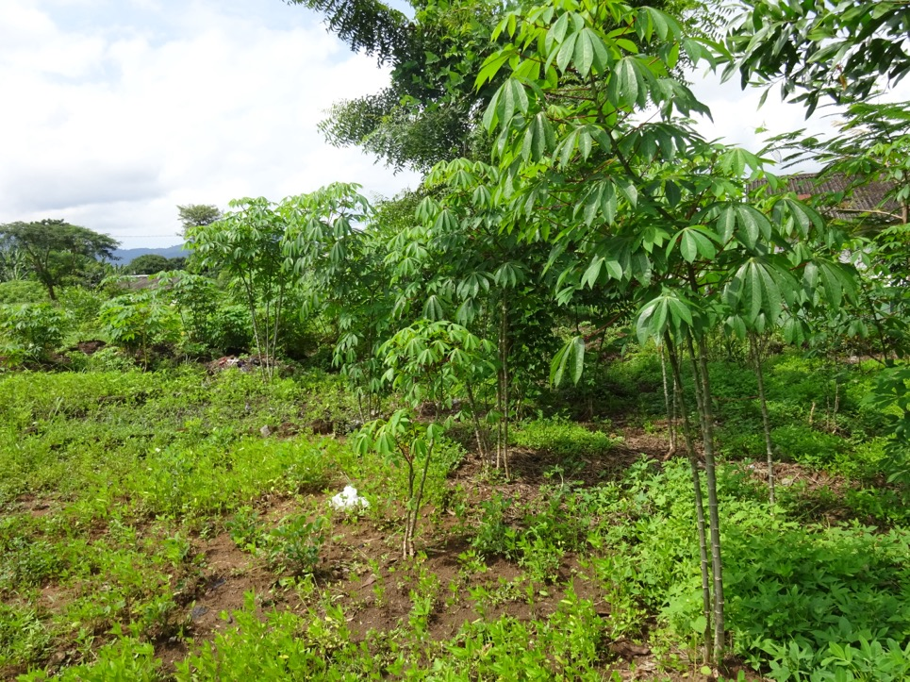
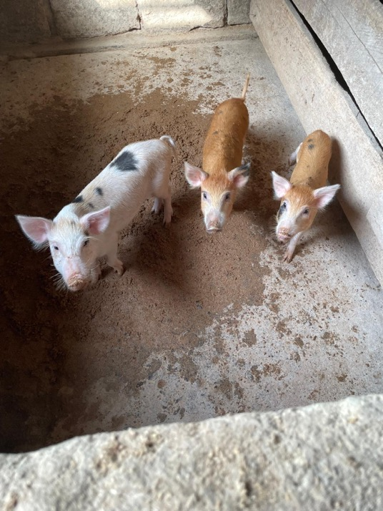
30 schools
Huntingdon School Farm
Ground nuts, corn, potato leaves … and pigs!

Slide 21
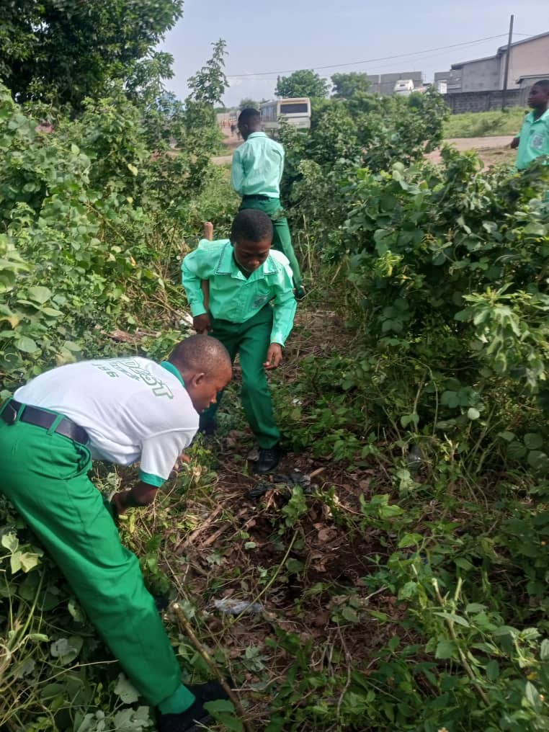
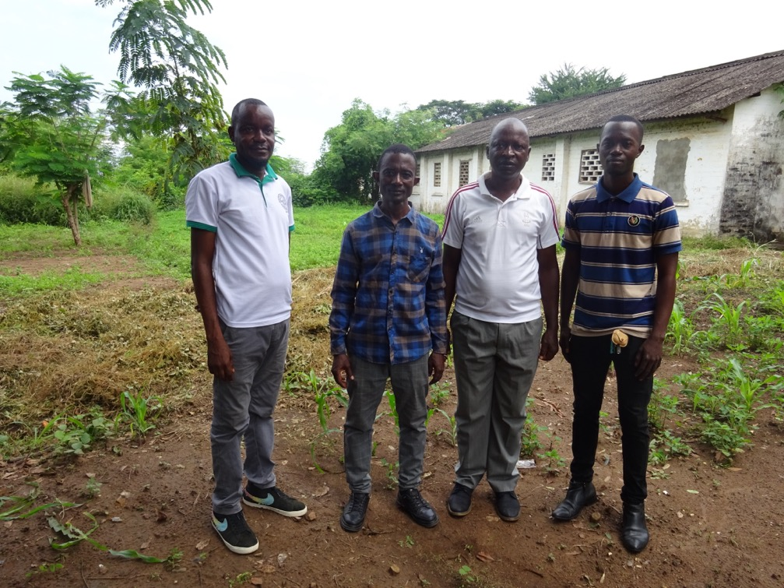
The Agriculture teachers and the pupils working

Slide 22
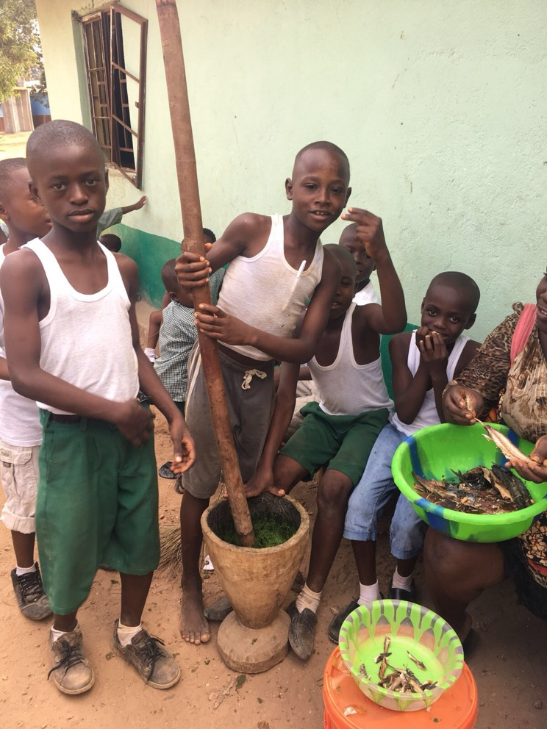
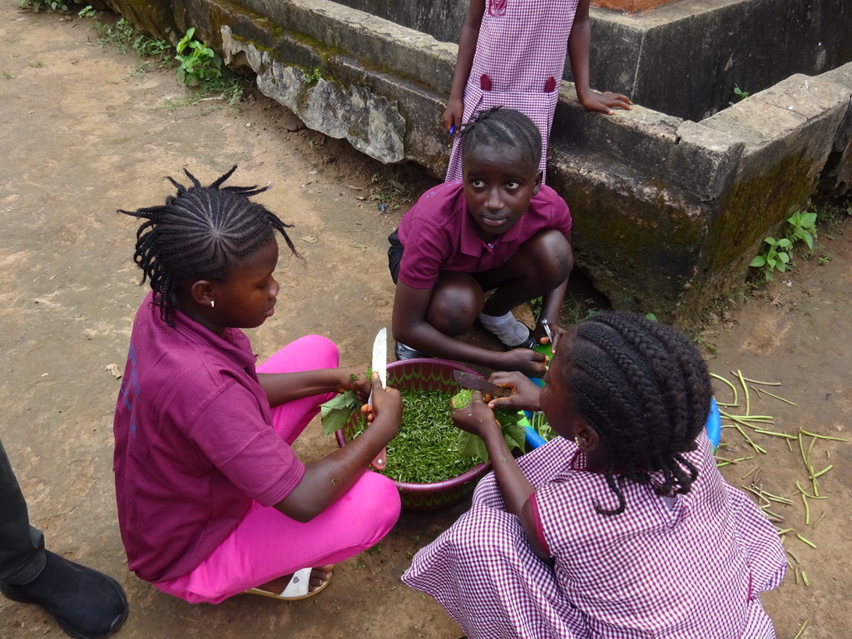
Pupils learning how to cook the harvest

Slide 23
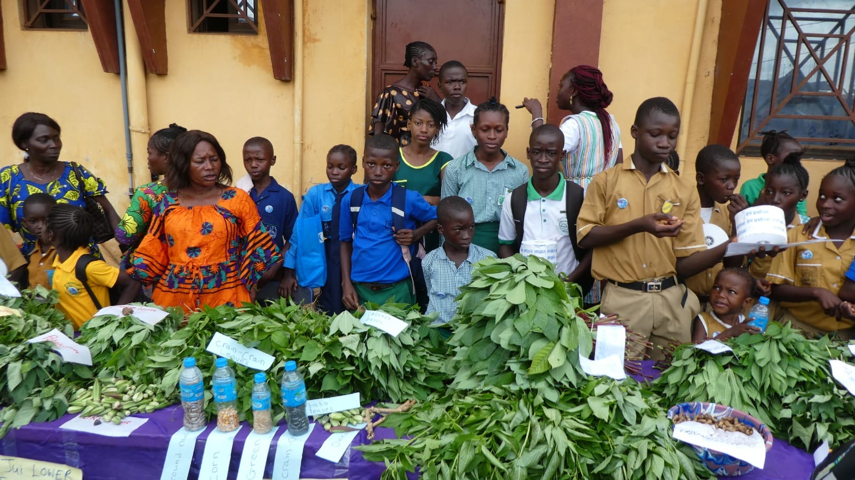
Harvest Festival 2025

Slide 24
Finances
£1000 per year
More help if needed
Problems include watering cans and animal intrusion

