Slide 1
Hastings Sierra Leone Friendship Link Schools Farms Project Report
2023

Slide 2
Our schools and their partners
All Saints CE Primary Academy Edest
St Pauls CE Primary Academy REC Kossoh Town
Christ Church CE Primary Academy Kankalay
Guestling Bradshaw CE Primary School Maynard
Battle Abbey Secondary School Kelly’s Vocational College
Battle and Langton CE Primary School Jui Lower
St Leonards CE Primary Academy Model Baptist, Grafton
Sacred Heart RC Primary School REC Hastings
St Mary Magdalenes RC Primary School Beckley
Sedlescombe CE Primary Academy REC Jui Upper
St Peter and St Paul’s CE Primary School Glory
Ore Village Primary Academy St Mulumba
Claverham Community College Huntingdon Kola Tree JSS

Slide 3
School Farms Project 2023/24
A brief history
The School Farms Project 2023/4 builds on the success of previous years.
30 schools
£1000 for the managers to decide how this should be spent.
Local supervision
Project Manager, Mrs Jeitta Kanneh and Suffian Kamara, Assistant Project Manager, with support from Francis Mason, HSLFL Schools Coordinator in Sierra Leone.
International information sharing
Jeitta, Suffian, Francis, Isabel, Roger and David form the SF Committee, meeting regularly and interacting with HSLFL Trustees.

Slide 4
How it works
A workshop at the beginning of the farming year, usually around May time.
Agree objectives for the year, funding and responsibilities
Jeitta and Suffian visit schools on a regular basis during the year
Regular SFP meetings keep the UK members in the loop
A celebration Exhibition in November/December

Slide 5
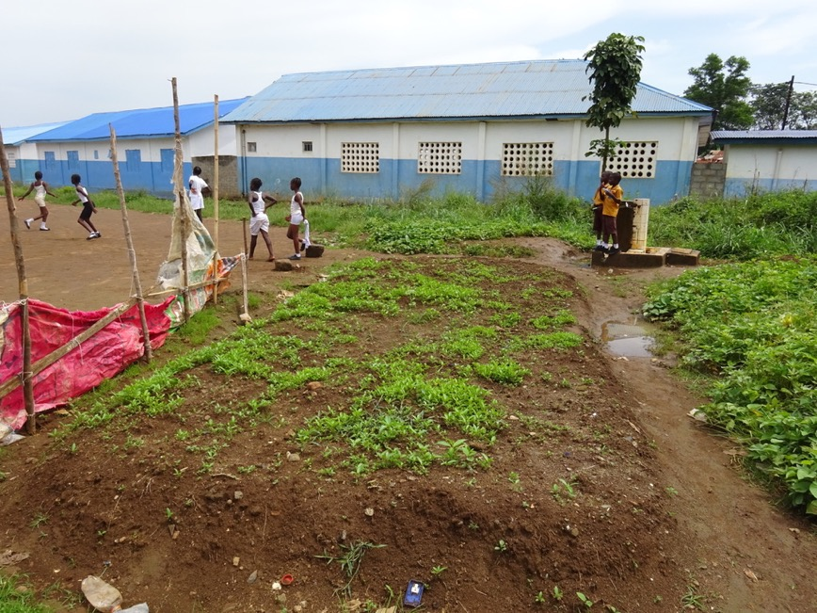

Slide 6
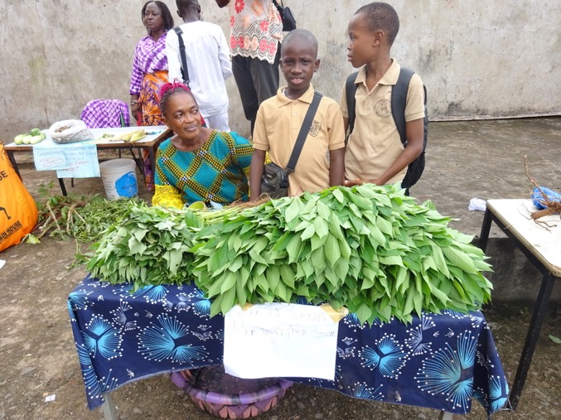
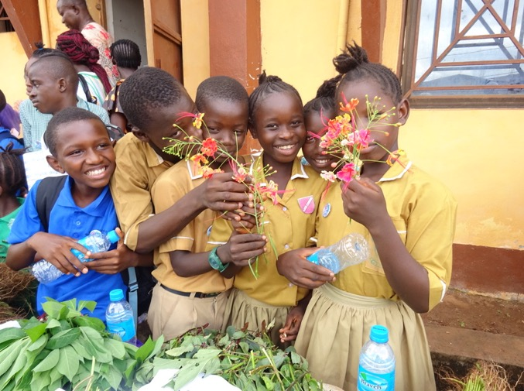
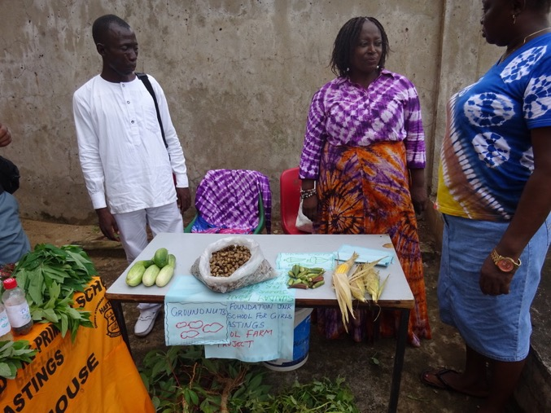

Slide 7
What happens to the produce?
Used for preparing school meals
Shared within the school and local community
Sold to buy more seeds, garden tools, fertilisers, fencing
Sold to buy resources for schools

Slide 8
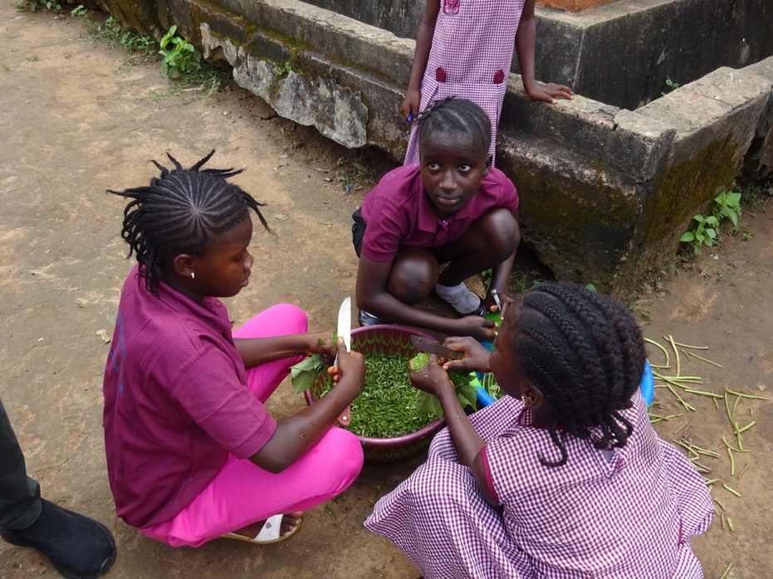

Slide 9
2023/4 aims and Longer term aims
To expand the school garden project which started in 2020,2021 and 2022 to include sustainability.
Enhance community participation and collaboration in the 2023 school farm project
To continue building capacity through workshops and raise awareness on what the school farm project is all about.
Products from school farm project 2023 to benefit schools, children, and the community.
To continue to teach Practical Agriculture in more and more schools
To work together with Local Community
To create more livelihoods in Agriculture and Farming
To become sustainable eventually without further funding

