Slide 1
Hastings Sierra Leone Friendship Link Schools Report
2023

Slide 2
Our schools and their partners
All Saints CE Primary Academy Edest
St Pauls CE Primary Academy REC Kossoh Town
Christ Church CE Primary Academy Kankalay
Guestling Bradshaw CE Primary School Maynard
Battle Abbey Secondary School Kelly’s Vocational College
Battle and Langton CE Primary School Jui Lower
St Leonards CE Primary Academy Model Baptist, Grafton
Sacred Heart RC Primary School REC Hastings
St Mary Magdalenes RC Primary School Beckley
Sedlescombe CE Primary Academy REC Jui Upper
St Peter and St Paul’s CE Primary School Glory
Ore Village Primary Academy St Mulumba
Claverham Community College Huntingdon Kola Tree JSS

Slide 3
Funding for Visits and Projects
British Council is no longer giving grants
Funding now raised through
HSLFL donations,
schools fund raising events
other charities (Fonthill Foundation this time)
individual donations

Slide 4
Our October 2023 visit to Sierra Leone The first one since Covid in 2020
12 teachers, 4 HSLFL members and Yvonne Johnson
Timetable included
Joint training workshop
Headteachers workshop
Work in schools for teachers,
Visits to schools by Isabel, Corinne and Jeitta
Sanitation Meeting and visits to schools by Richard, Alex and Suffian
Reflection meeting
International Pupil Council meeting
School Farms Exhibition

Slide 5
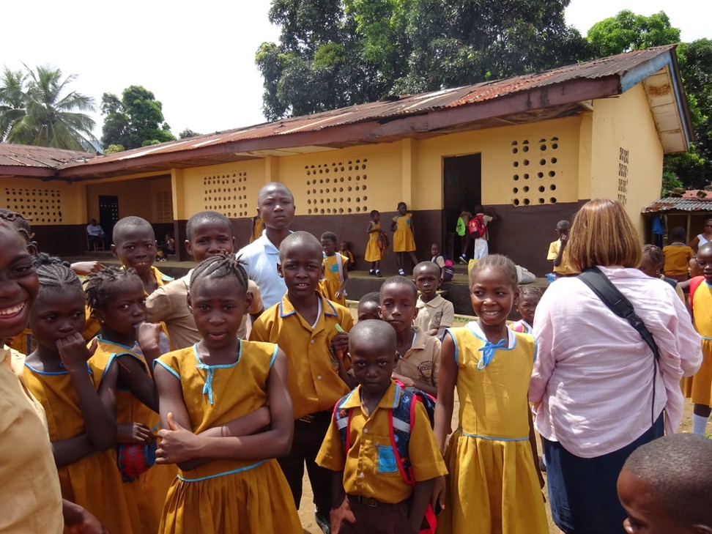
Glory and REC Hastings

Slide 6
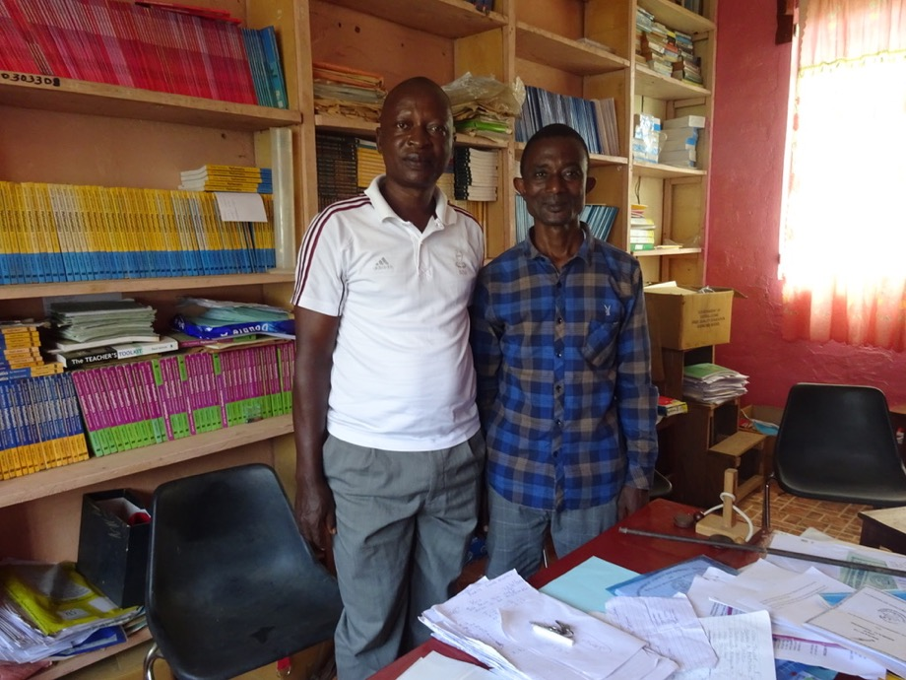
Huntingdon Kola Tree and Jui

Slide 7
We also fitted in …… Not bad for 8 days!
A cooking lesson
Visit to the Chimpanzee Sanctuary
Lots of eating out courtesy of Yvonne, Mimi, Francis and Abie, and the school teachers
A visit to the beach
A visit to Francis Mason’s new project
A visit to Freetown, sight seeing and shopping
A meal out, treating our partners for all their hard work, support, friendship and care during our visit

Slide 8
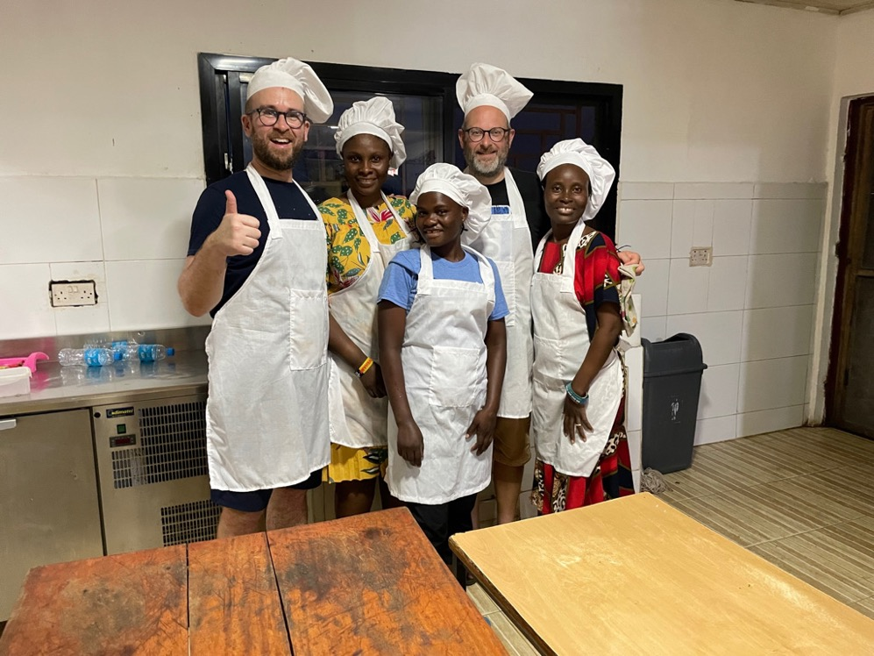

Slide 9
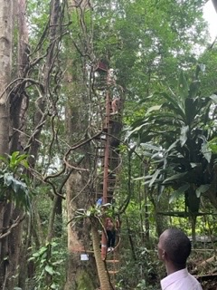

Slide 10
Our 2023/4 Joint Project ‘Protecting Our Future’
Planting trees
Recycling waste for classroom resources
………. And more to come

Slide 11
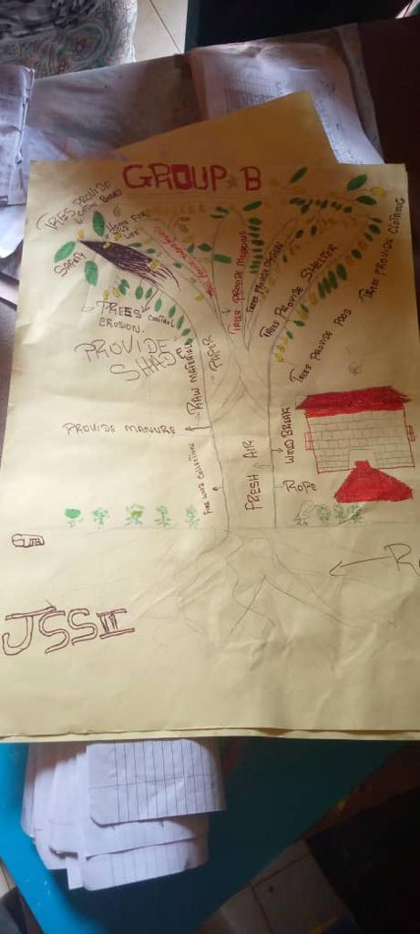
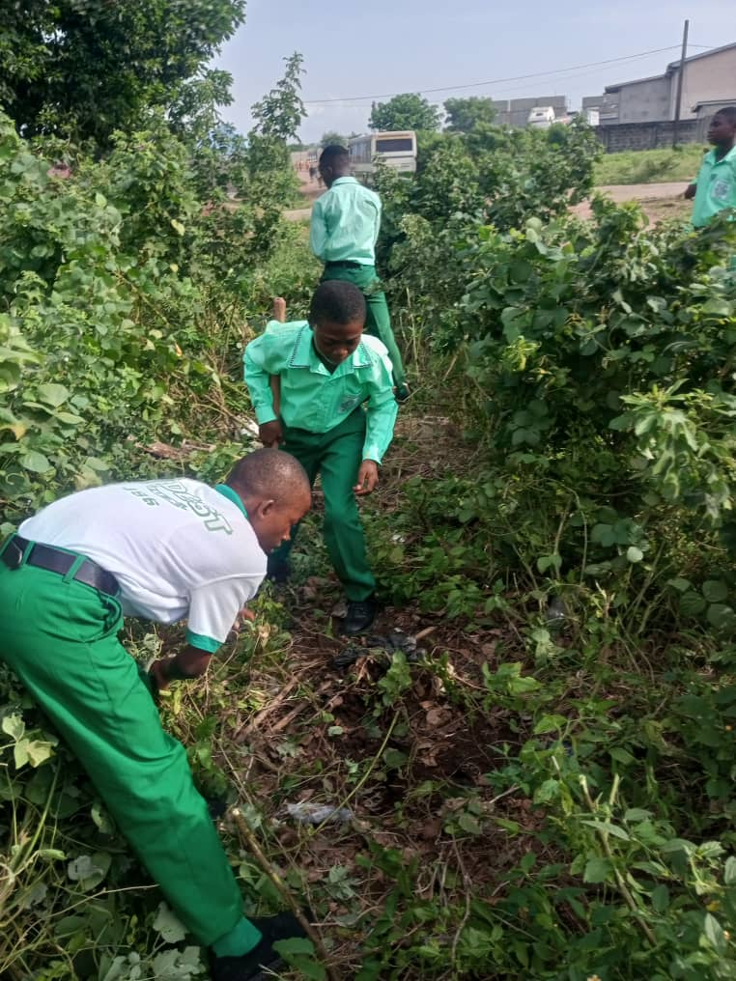

Slide 12
What next?
Regular School Meetings
Regular IPC meetings
Plans to bring Sierra Leone colleagues to UK in June 2024
Build on our 2023/4 project ‘Protecting our Future’
Share plans and successes with colleagues in Sierra Leone
Francis Mason – Schools Coordinator
Teachers in partner schools and others interested
Jeitta and Suffian, School Farms Managers

Slide 13
Other activities
International Pupil Councils
School Farms Project
Sanitation Project

Slide 14
