Slide 1
Hastings Sierra Leone Friendship Link School Farms Project 2021

Slide 2
Seeds Challenge 2020
Battle Horticultural Society generously donated £200 for schools in Hastings Sierra Leone to grow vegetables
In February 2020 twenty-one local schools received 108,000 Le (equivalent to £9) in order to create school gardens
Seeds were sown by teachers and pupils at the beginning of the rainy season
This HSLFL project was referred to as the SEEDS CHALLENGE 2020.

Slide 3
What happened …..
Schools grew a range of staple vegetables (including cassava leaves, corn, crain crain, garden eggs, green leaves, ginger, groundnuts, okra, onions, potatoes, sorrel, tomatoes)
Throughout the growing season HSLFL received photographs/videos of verdant gardens of lush green vegetation tended by energetic pupils and their teachers.

Slide 4
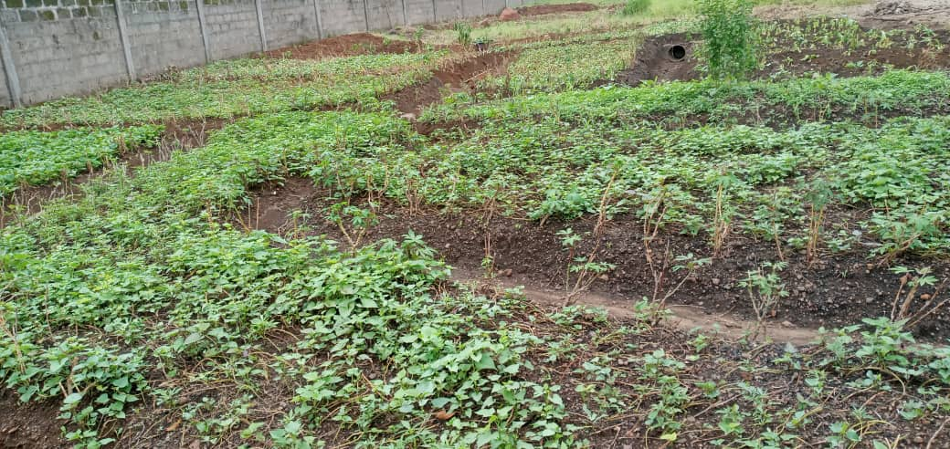
Kelly’s Vocational College

Slide 5
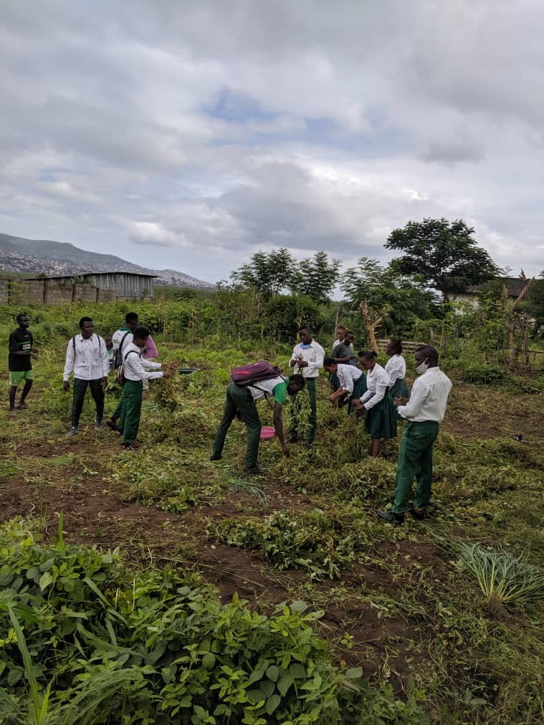
Huntingdon Jui

Slide 6
The Results
Crops were harvested later in the rainy season. Some schools stored seeds for sowing the following year
Vegetables were cooked to provide meals for pupils, teachers or parents. Income from any sale of produce was generally spent to benefit the school or buy more seeds
A Questionnaire was sent to all schools to receive their feedback and the level of interest for continuing the project in the future
Responses were unanimously positive and schools requested further development of this successful project.

Slide 7
School Farms Project 2021
The SCHOOL FARMS 2021 project builds on the success of the SEEDS CHALLENGE. It’s long term objectives are focused on creating opportunities for employment through learnt skills and the involvement of local communities
Participating schools agreed to work in a more structured project with more help and more accountability.
Local supervision of the project is carried out by the Project Manager, Mrs Jeitta Kanneh, with the support from Francis Mason, HSLFL Schools Coordinator in Sierra Leone.
Jeitta, Francis, Isabel, Roger and David form the SF Committee, meeting regularly and interacting with HSLFL Trustees.

Slide 8
How did it start?
A workshop to introduce Head Teachers to the SCHOOL FARMS Project 2021 was facilitated by Jeitta and held at Francis’s Conforti compound in March.
Twenty-four Head Teachers attending the workshop, agreed to the aims and objectives of the project and accepted the responsibilities and accountability
Schools received 260,000 Le (equivalent to £20) in order to buy materials to grow their crops (seeds, fertiliser, tools etc.).

Slide 9
Aims and Objectives
To develop annual planting and harvesting
To become self sustaining
To build skills in agriculture
To Involve the local community in work on the farm
To create an awareness of opportunities for employment in the agricultural industry.

Slide 10
Schools’ Commitments
Attend Introductory Workshop
Maintain regular contact, receive visits from the Project Manager and provide progress updates as required
Provide details of crops grown, including photographs/videos to Whats App group (SL and UK)
Ensure that students are involved in all aspects of work on the farm

Slide 11
School Commitments continued
Give harvested vegetables to those in need in the school (maybe as meals) or to the community
Any Income from sale of vegetables to benefit the school or local community or to buy materials for the following year
Attend a second workshop at the end of the growing season to share experiences and learning, and discuss ideas of any future improvements.

Slide 12
What happened
During the growing season Jeitta made several visits to all 24 schools. regularly reporting back to the School Farms Project Committee
Individual schools have also been exemplary in recording the development of their farms. Sharing their experiences and achievements with other schools and with HSLFL
The SFP Committee has been meeting regularly to record progress against objectives and commitments

Slide 13
The Results!
Results have been spectacular. Farms are extensive and proudly maintained with enthusiasm and energy by both school staff, pupils and members of the local community.
Students are learning agricultural skills and have practical experience to supplement the theoretical knowledge of previous curriculum studies.
Schools have mainly cultivated the staple vegetables and many have harvested second crops. Other initiatives include creating plant nurseries for seedlings and setting up irrigation systems.
A further initiative by individual schools involved growing rice and rearing pigs!

Slide 14
Kankalay and Christ Standard

Slide 15
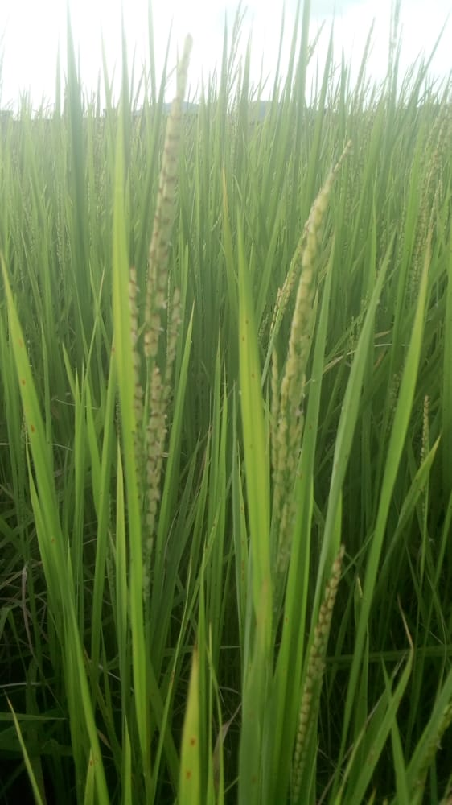
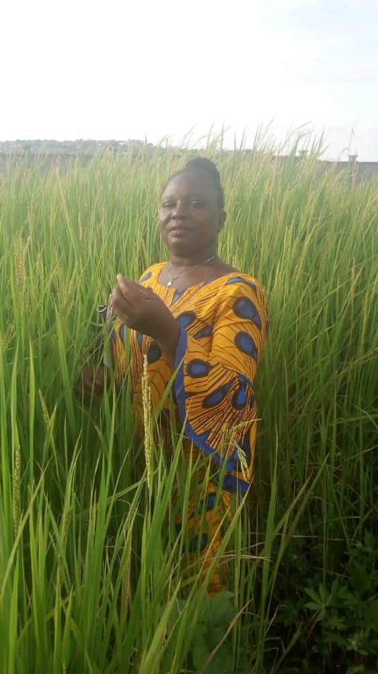
Pigs at Edest and Rice at Kossoh Town

Slide 16
What is happening now …. End of Season Workshop
To share learning experiences and achievements against the Aims and Objectives.
To analyse What Went Well, (WWW) Even Better If …? (EBI)
To agree plans for the future.
To share long term objectives

Slide 17
Aiming for Sustainability
To continue to teach Practical Agriculture in schools
To develop farms so that many students gain further Agricultural skills
To work together with Local Community to develop Community Farms
To create more livelihoods in Agriculture and Farming

