Slide 1
Hastings Sierra Leone Friendship Link Schools Report
2019 - 2021

Slide 2
Our schools and their partners
All Saints Edest
St Pauls Kossoh Town
Christ Church Kankalay
Guestling Bradshaw Maynard
Claverham Community College Huntingdon Kola Tree
Battle Abbey Secondary Kelly’s Vocational College
Battle and Langton Jui Lower
St Leonards CE Model Baptist, Grafton
Sacred Heart REC Hastings
St Mary Magdelenes Beckley
Sedlescombe Jui Upper

Slide 3
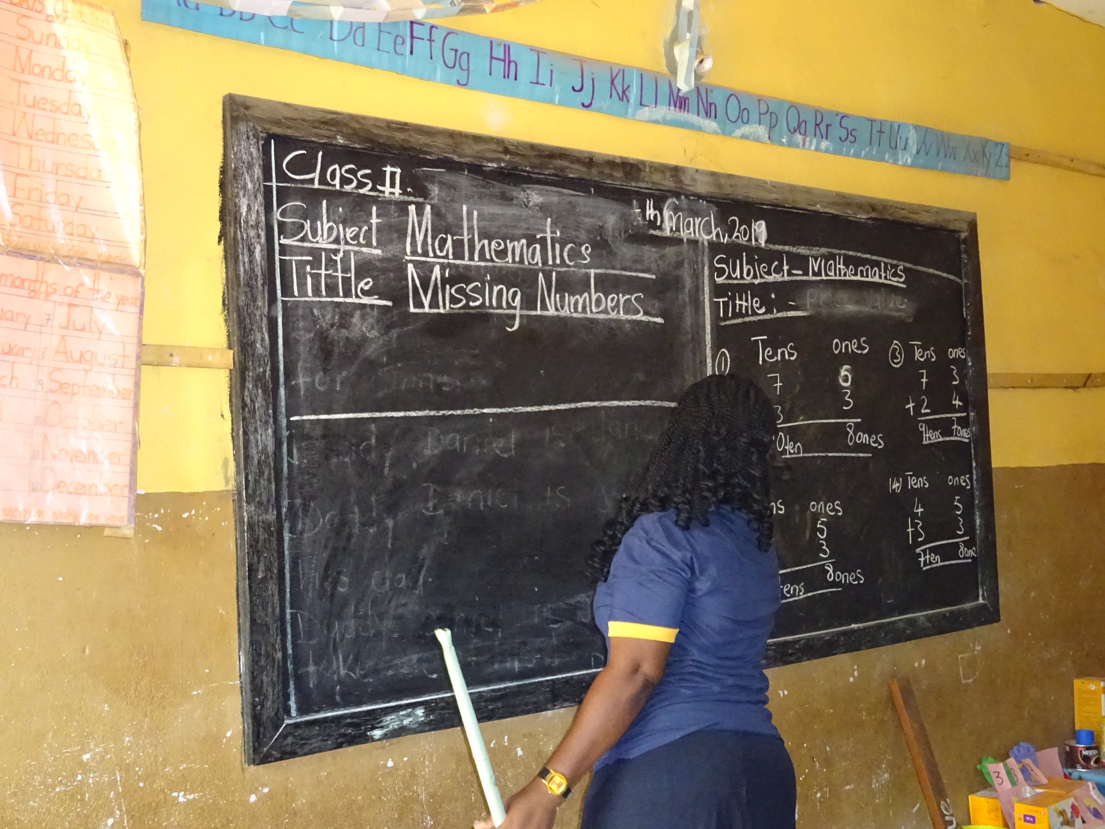
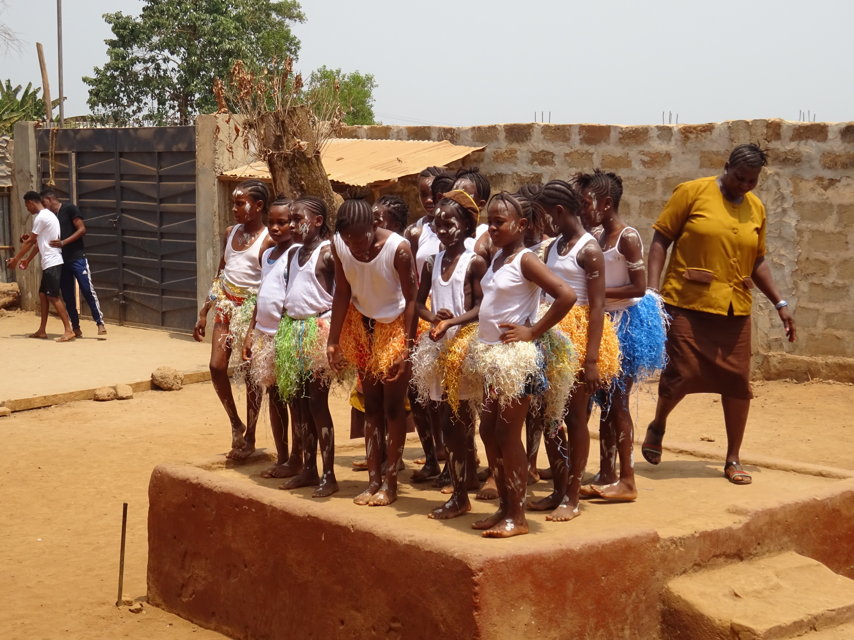
Kankalay, Jui Upper and Beckley

Slide 4
Sierra Leone schools looking for partnerships
Hunting Jui Secondary
St Mulumba
Glory
Christ Standard
Rokel

Slide 5
British Council Grant funding
Cluster grants 2018-2021
Training
Zero Waste Project
Reciprocal Visits
Community Celebrations

Slide 6
Training
All teachers gained a Global Teacher Award.

Slide 7
Reciprocal Visits
February 2019 – Claverham Community College installed a solar panel, laptop, projector and screen at Huntingdon Kola Tree with money raised by the school
June 2019 – Teachers from Sierra Leone visited UK
February 2020 – 18 teachers and 5 HSLFL members visited Sierra Leone, the largest group ever.
First ever joint training day run by teachers from UK
First ever cooking lesson
First ever visit to the Chimpanzee Sanctuary (for most of us)
First ever taste of giant prawns!
Sadly no further visits since then.

Slide 8
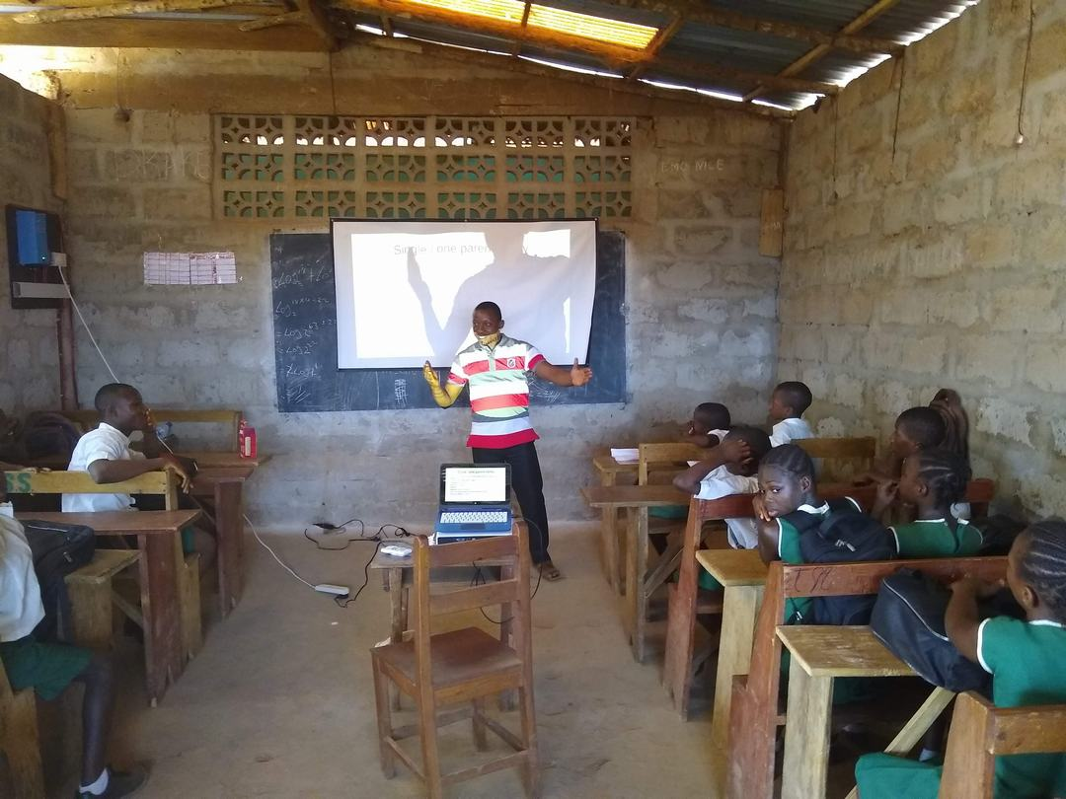
Making use of the solar panel powered laptop and projector at Huntingdon Kola Tree

Slide 9
Infant classes at Rokel

Slide 10
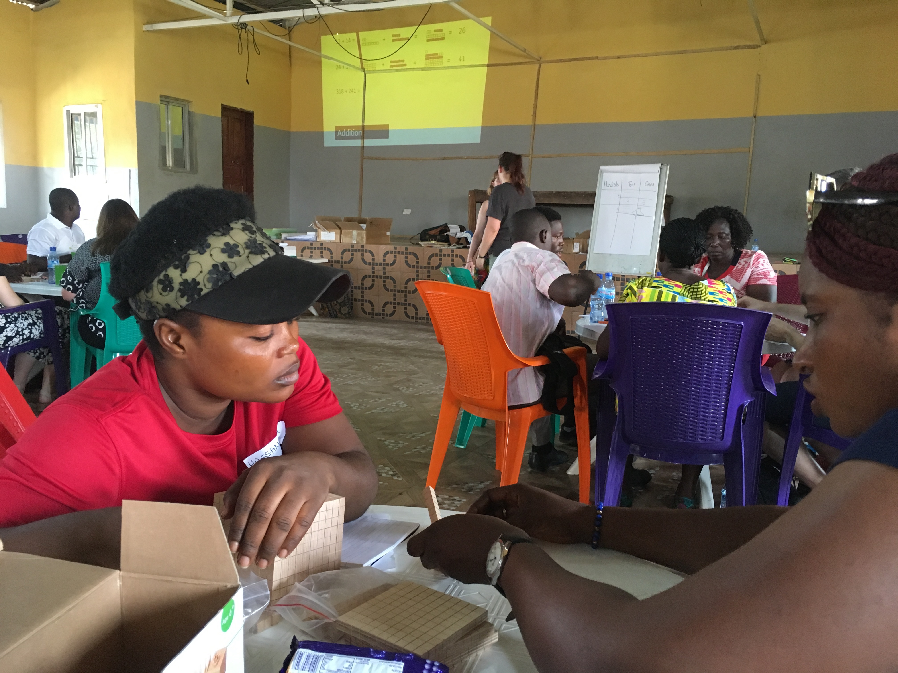
Our first ever joint training session run by teachers

Slide 11
Zero Waste Projects
These include in the UK
A beach and street clean
Collecting pens, crisp packets etc for recycling
Reducing electricity usage
These include in Sierra Leone
Waste bins in every classroom
Compost bins in most schools
Planting trees

Slide 12
Community Celebrations
In 2020 this took place in the Twin Town Centre
A virtual Community Celebration is now being set up in UK ready for viewing hopefully before Christmas.

Slide 13
Other activities
International Pupil Councils
School Farms Project
Sanitation Project
Soccer Tournament
Social events

Slide 14
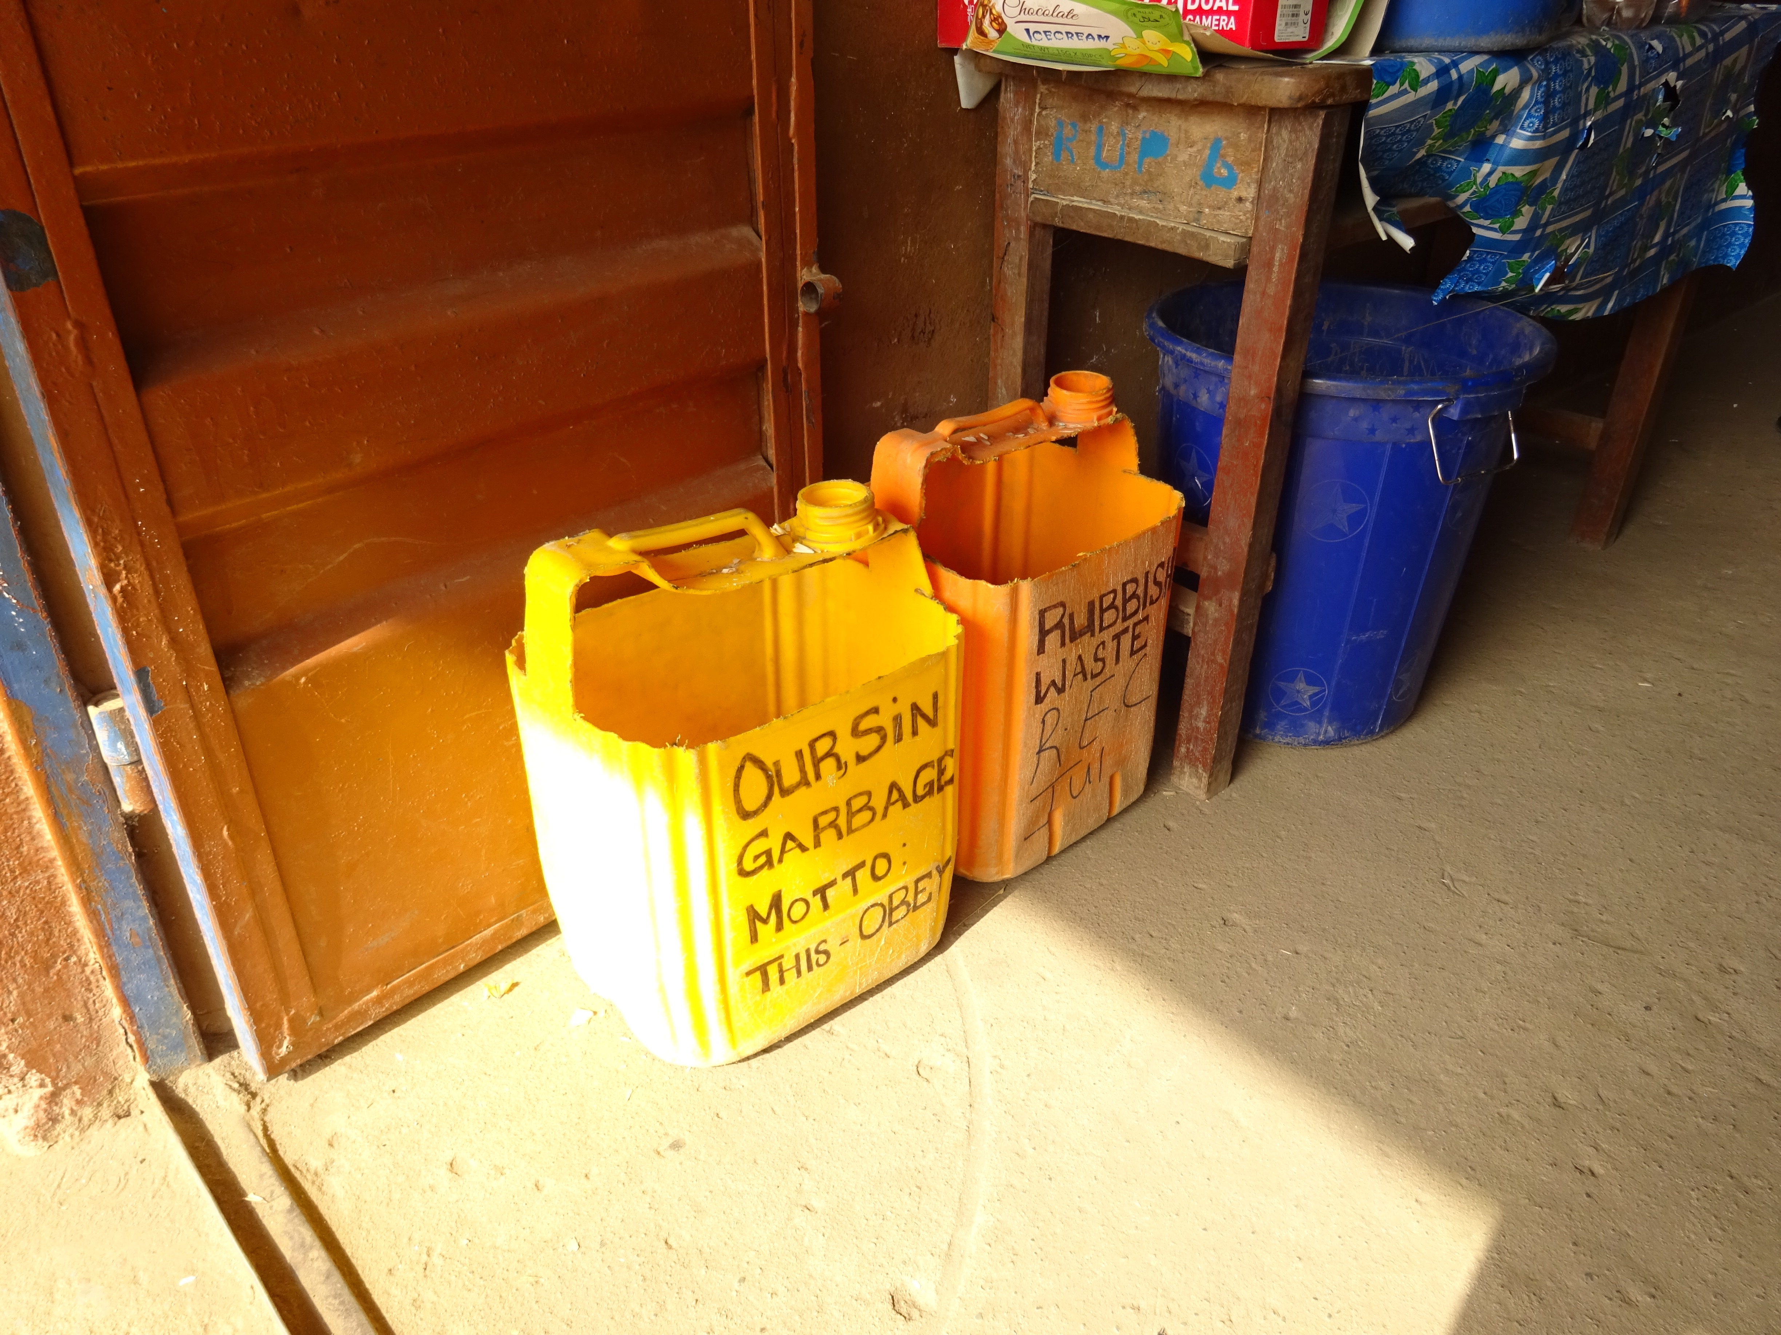
IPC 2019 talking about waste recycling

Slide 15
What next?
Reconnect with UK schools in the spring
Watch for new British Council grant funding
Start IPC meetings again
Regular School Meetings
Keep connections with colleagues in Sierra Leone
Francis Mason – Schools Coordinator
Kelly Ferguson – Head of British Council in Freetown
Teachers in partner schools

