Slide 1
Hastings Sierra Leone Friendship Link Seeds Challenge
With the help of the British Council Connecting Classrooms Grant
Isabel Hodger – Schools Co-ordinator

Slide 2
The Challenge
The Hastings Sierra Leone Friendship Link (HSLFL) has 13 partnerships between schools in Hastings UK and Hastings Sierra Leone. Supported by British Council grants, annual reciprocal visits are made by teachers, accompanied by other Link volunteers. In February 2020, 23 members of the UK Link visited Sierra Leone, the largest group ever to have travelled, thanks in part to British Council funding.
In January 2020, The Battle Horticultural Society donated a generous £200 towards buying seeds for our friends in Sierra Leone. We took the money to distribute between our schools. In all 21 schools in the area accepted approximately £9 each with the promise that they would let us know how they progressed.

Slide 3
The Results
Amazing! Nearly all the schools were able to buy seeds and grow crops during the summer, despite the Covid lock down and the schools closing. Teachers used school grounds, their own gardens, some neighbouring fields and other available spaces to plant a range of crops. These included corn, crain crain, cassava, groundnuts, tomatoes, okra, potatoes, water melon, green vegetable leaf, ginger and sorrel.
The harvest was used in several ways. Some schools distributed between families, teachers, children and the local community. Some schools sold some of their crops to buy more seeds for a second harvest. Some bought resources for their classrooms and one school used some of the money to buy stationery and a graduation present for their school leavers.

Slide 4
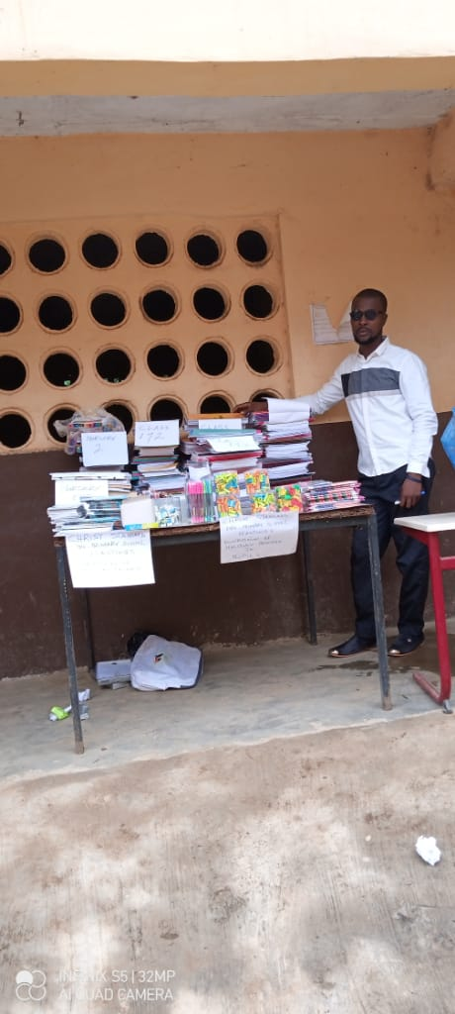
Christ Standard stationery gifts bought using money from crops

Slide 5
Christ Standard response to the project
Daniel writes “I would like to thank the sponsors of this challenge. Despite the corona virus is has been so successful. It has encouraged teachers to appreciate the value of this cultural partnership. The proceeds from selling the crops have been used to buy stationery and graduation gifts for the pupils. They were so amazed and happy to receive them. We would like to express our thanks and appreciation to all the organisers, and say that we would like more projects like this in the future.”

Slide 6
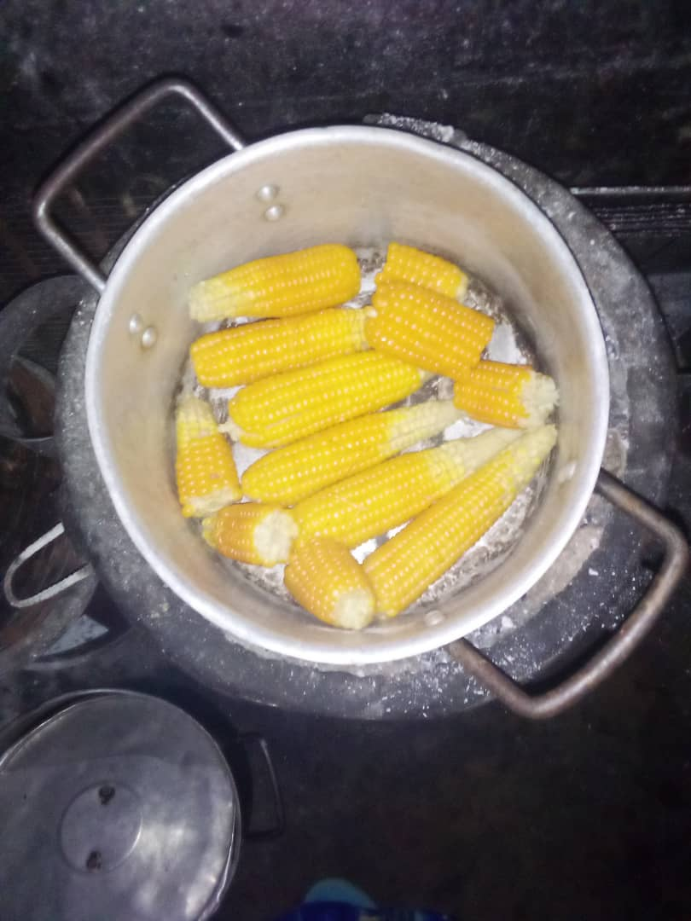
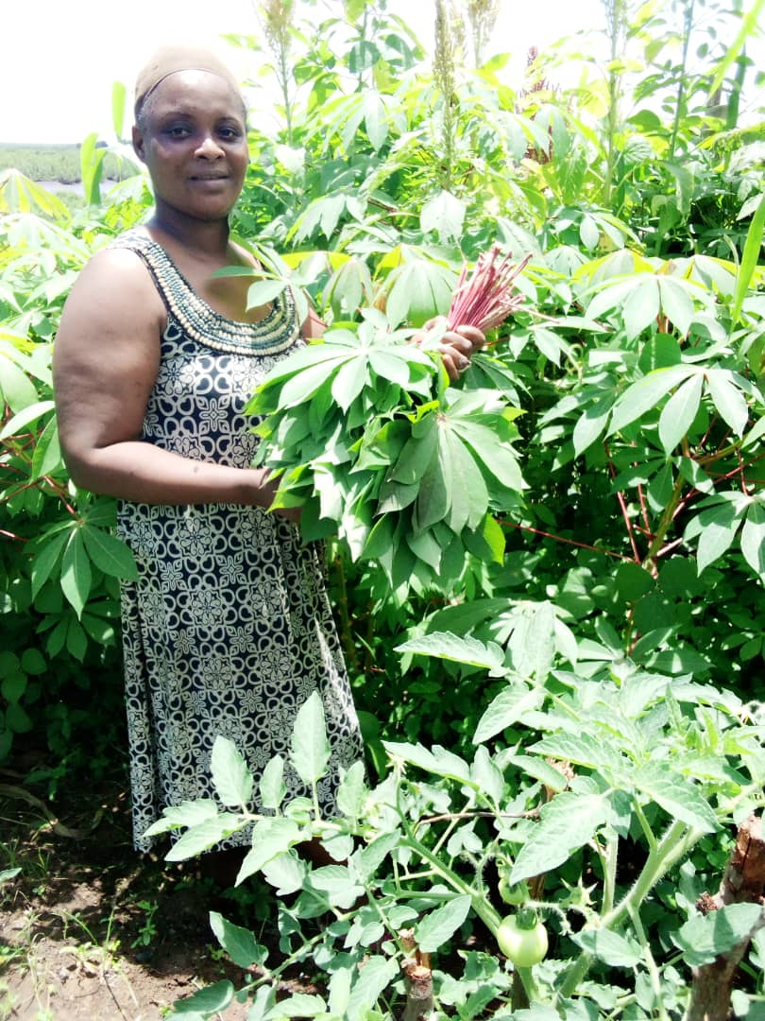
Letitia’s garden. She helped organise the Seeds Challenge in Sierra Leone.
“In my garden I have grown tomatoes, groundnut, watermelons, okra, ginger, sorrel, corn, potatoes and cassava. I shared some corn with the children in my small school that I organised at home during lockdown.”

Slide 7
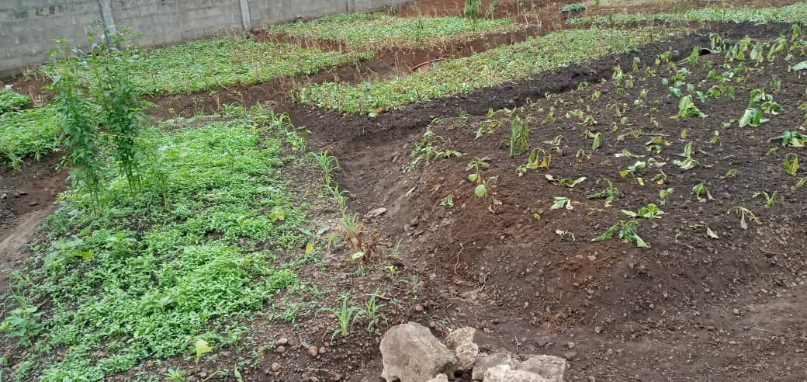
Kelly’s Vocational College Head teacher Christiana Ayo-Speck “My students planted these seeds in the school compound before lockdown.”

Slide 8
Kellys response to the project
Christiana Ayo-Speck writes “ This project has been very helpful. It has involved the pupils in planting and growing and has given them food to eat. Bravo to everyone who made it happen!”

Slide 9
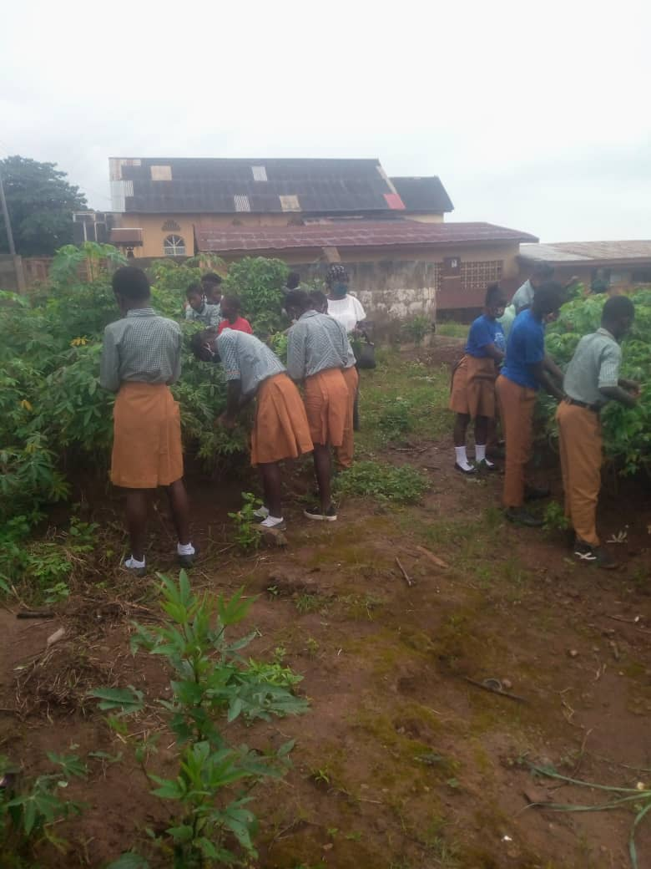
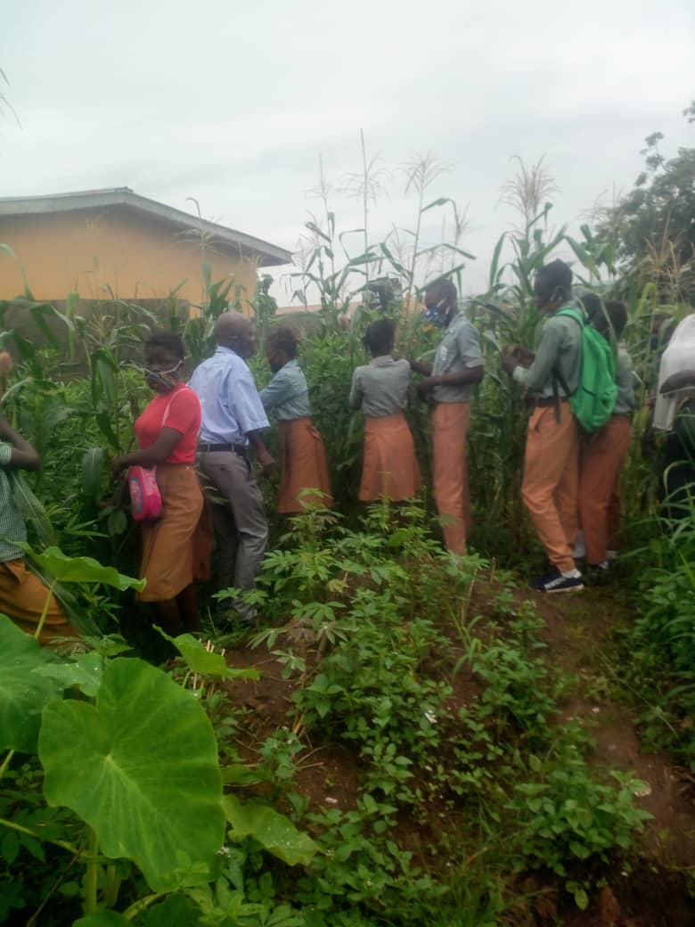
Rokel with head teacher Elizabeth Tucker “Students helped to grow and harvest crops with the help of their Rural Science teacher.”

Slide 10
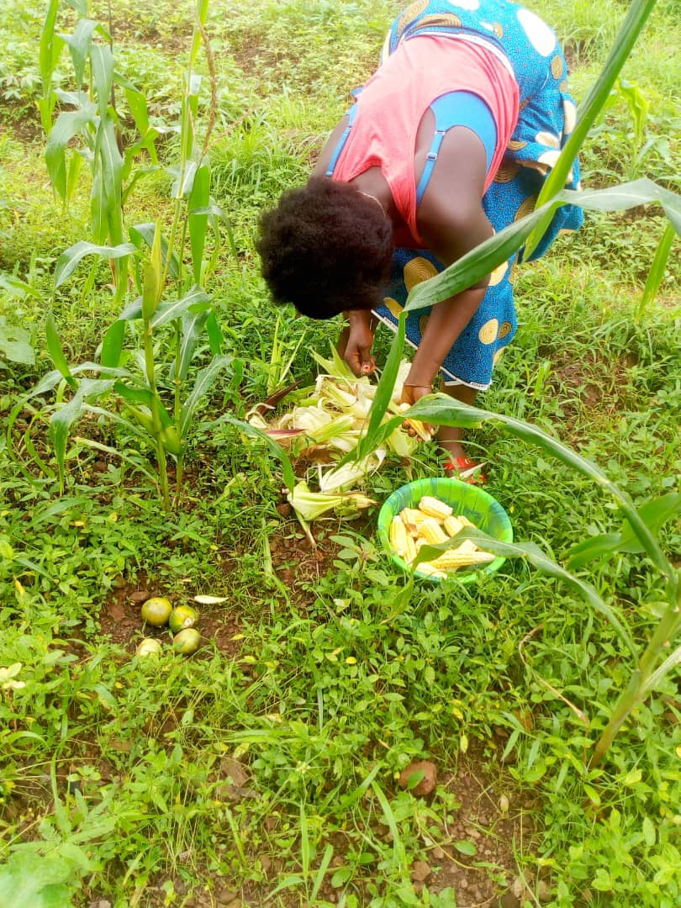
St Mulumba with head teacher Elizabeth Lamin
“For me I planted my seeds near my house and I have harvested the corn, crain crain and green and sold it at 150000 Le. So by the time we reopen I will get the money back to buy another seeds for planting in school.”

Slide 11
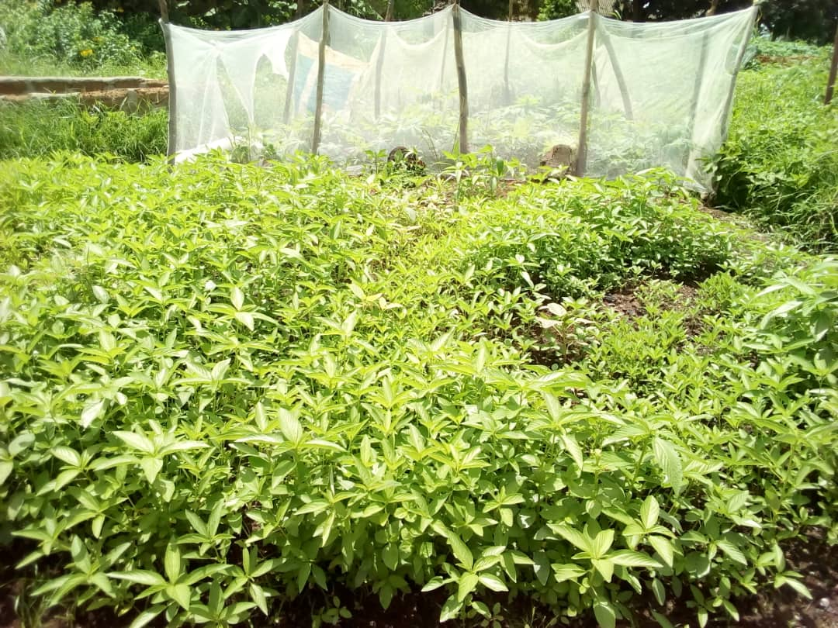
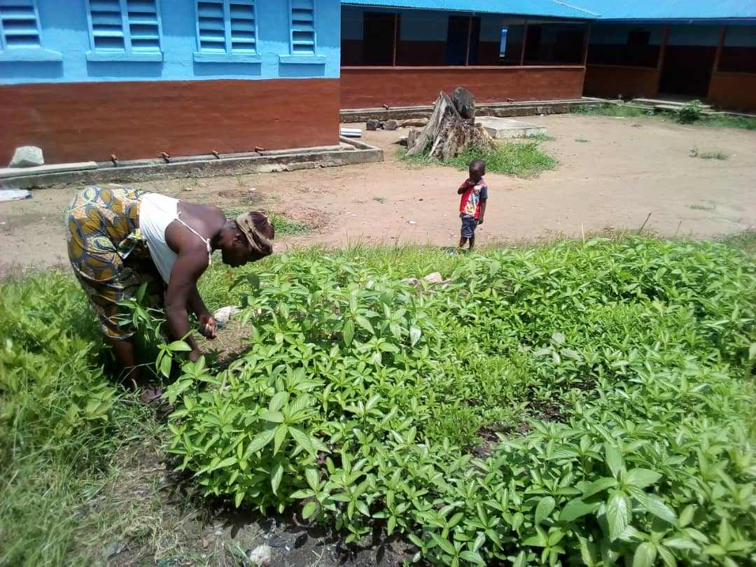
Jui Upper “The head teacher of R.E.C Jui Upper Infant School harvesting one of the plants which is call crain crain” writes teacher Serrah Conteh.

Slide 12
So … with £200
21 schools received £9 to buy seeds
Many large areas of crops were grown and harvested
Many children, teachers, families, friends and schools benefitted from the harvest.
Some crops were eaten, some were sold.
New seeds were bought to plant a further crop.
Equipment was bought for schools.
Well done to all the schools who took part in this challenge and worked hard to make it so successful.

Slide 13
What next?
The HSLFL has 4 areas for development. Education, Health, Infrastructure and Livelihoods.
David Lewis, leading on Livelihoods is proposing projects to support vocational training, provide local employment and create sustainable businesses. Following the success of this year’s Seed Challenge a School Farms Project is currently planned for 2021”.
We are now exploring which schools would be interested in following up their success by becoming part of this ‘School Farms Project’.
Follow our progress on
website www.hastingshastings.org.uk
Twitter @hastings_link
Facebook @sierraleonefriendshiplink

